Slide 1

Chapter 5
Eigenvalues and Eigenvectors

Slide 2
Core Topics
(i) The Characteristic Equation (5.2)
(ii) Basic Power Method (5.3)
(iii) Inverse Power Method (5.4)
(iv) Shifted Power Method (5.5)
(v) QR Factorisation and Iteration Method (5.6)
(vi) Use of Matlab’s built-in functions for determining eigenvalues and eigenvectors (5.7)

Slide 3
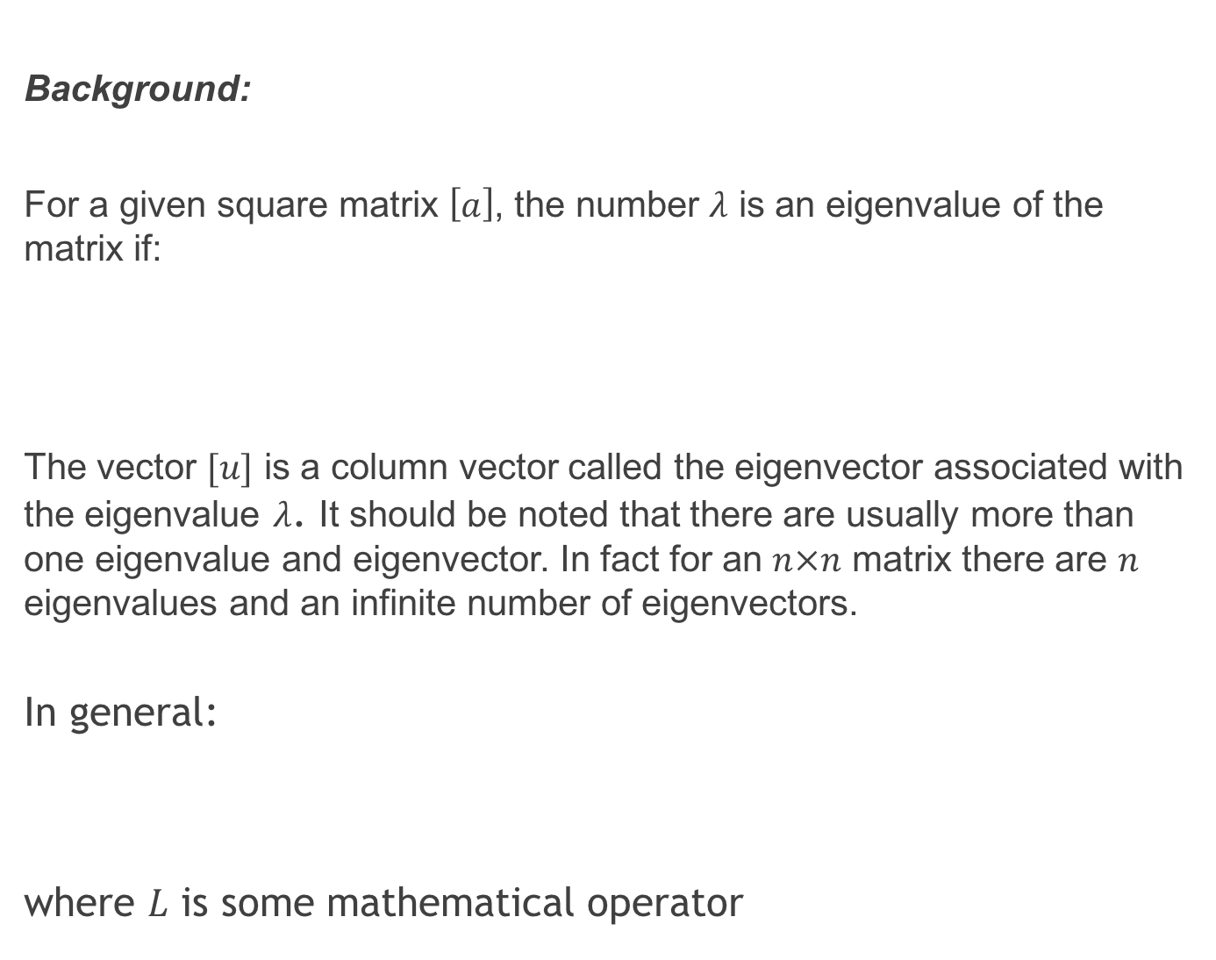
Background:
For a given square matrix $\left[a\right]$, the number $λ$ is an eigenvalue of the matrix if:
The vector $[u]$ is a column vector called the eigenvector associated with the eigenvalue $λ$. It should be noted that there are usually more than one eigenvalue and eigenvector. In fact for an $n×n$ matrix there are $n$ eigenvalues and an infinite number of eigenvectors.
In general:
where $L$ is some mathematical operator

Slide 4
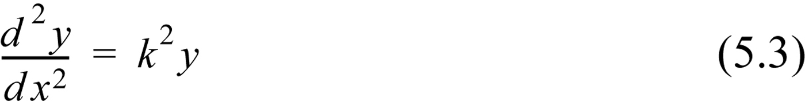
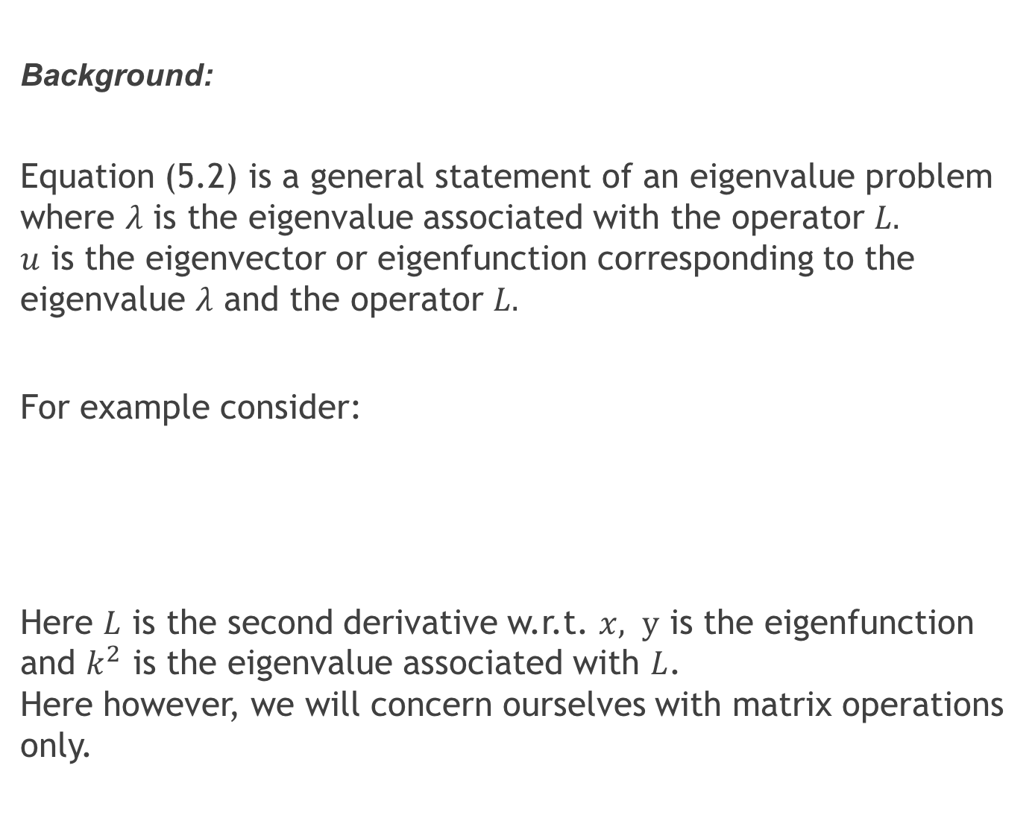
Background:
Equation (5.2) is a general statement of an eigenvalue problem where $λ$ is the eigenvalue associated with the operator $L.$ $u$ is the eigenvector or eigenfunction corresponding to the eigenvalue $λ$ and the operator $L.$
For example consider:
Here $L$ is the second derivative w.r.t. $x, y$ is the eigenfunction and $k^{2}$ is the eigenvalue associated with $L$. Here however, we will concern ourselves with matrix operations only.

Slide 5
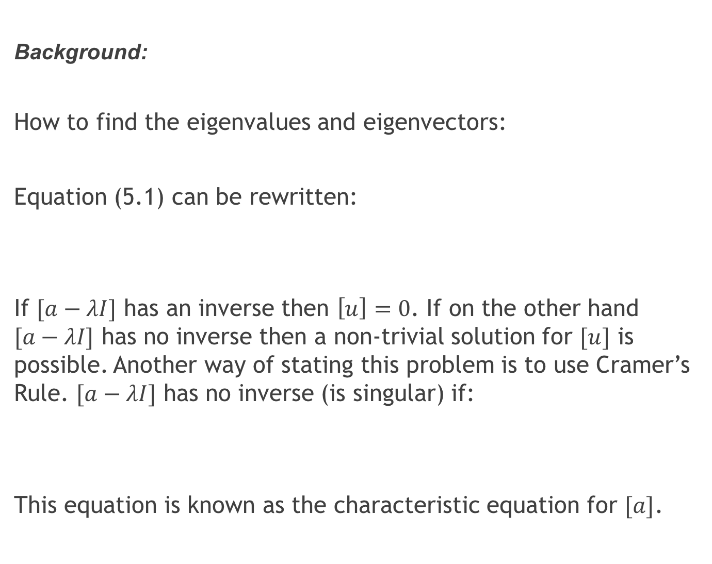
Background:
How to find the eigenvalues and eigenvectors:
Equation (5.1) can be rewritten:
If $[a−λI]$ has an inverse then $\left[u\right]=0$. If on the other hand $[a−λI]$ has no inverse then a non-trivial solution for $[u]$ is possible. Another way of stating this problem is to use Cramer’s Rule. $[a−λI]$ has no inverse (is singular) if:
This equation is known as the characteristic equation for $[a]$.

Slide 6
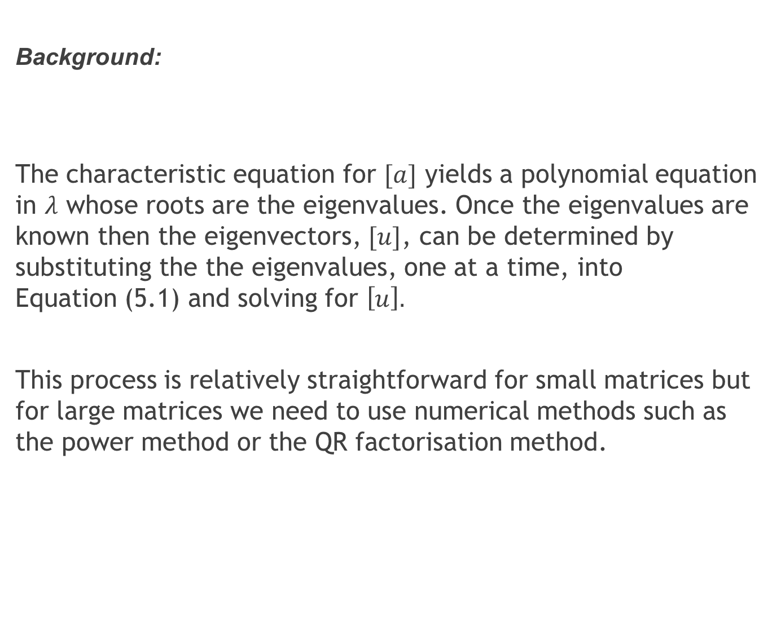
Background:
The characteristic equation for $[a]$ yields a polynomial equation in $λ$ whose roots are the eigenvalues. Once the eigenvalues are known then the eigenvectors, $[u]$, can be determined by substituting the the eigenvalues, one at a time, into Equation (5.1) and solving for $\left[u\right].$
This process is relatively straightforward for small matrices but for large matrices we need to use numerical methods such as the power method or the QR factorisation method.

Slide 7
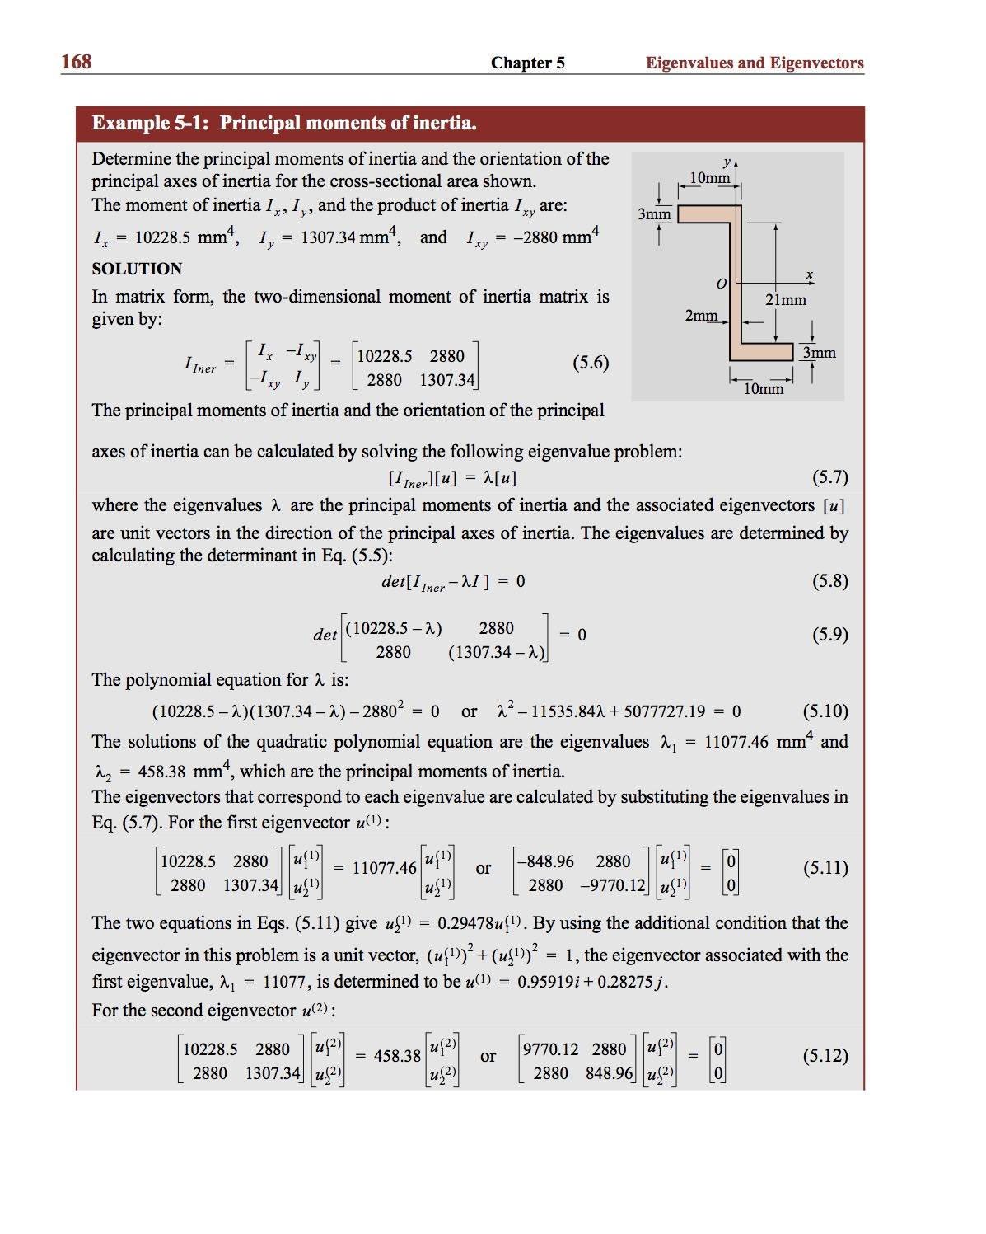
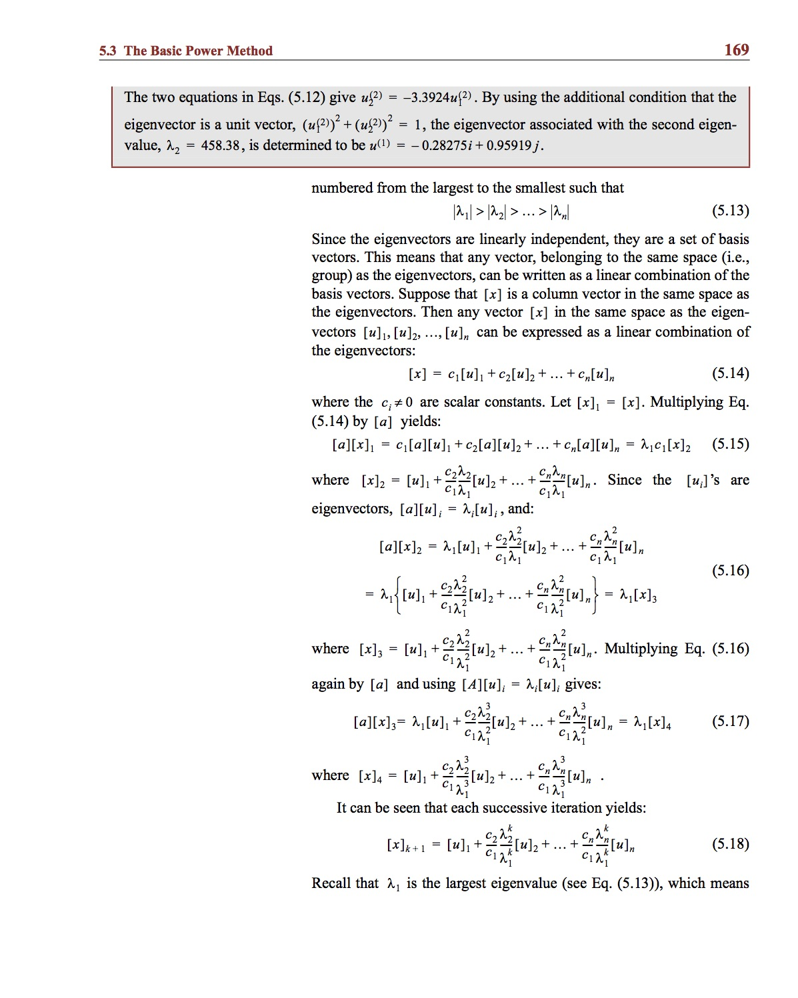
Example:

Slide 8
The Basic Power Method: This method is an iterative procedure for determining the largest real eigenvalue and corresponding eigenvector of a matrix. It is recommended that you study this proof over that given in the text.

Slide 9
The Basic Power Method:

Slide 10
The Basic Power Method:

Slide 11
The Basic Power Method:

Slide 12
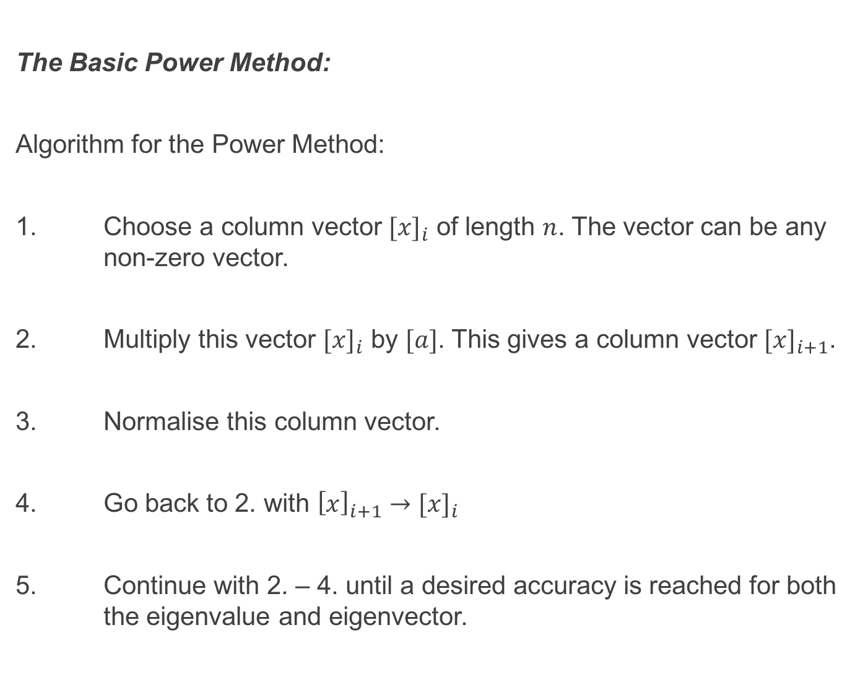
The Basic Power Method:
Algorithm for the Power Method:
1. Choose a column vector ${[x]}_{i}$ of length $n$. The vector can be any non-zero vector.
2. Multiply this vector ${[x]}_{i}$ by $[a]$. This gives a column vector ${[x]}_{i+1}$.
3. Normalise this column vector.
4. Go back to 2. with ${\left[x\right]}_{i+1}→{[x]}_{i}$
5. Continue with 2. – 4. until a desired accuracy is reached for both the eigenvalue and eigenvector.

Slide 13
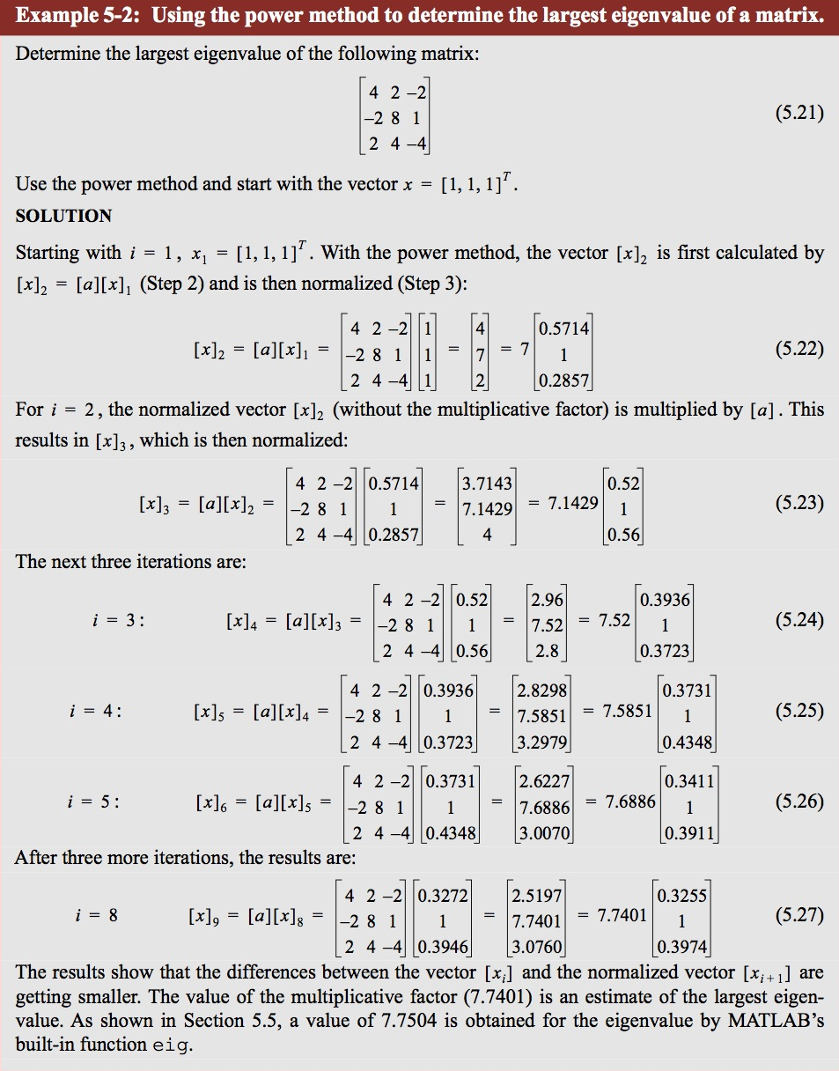
Example:

Slide 14
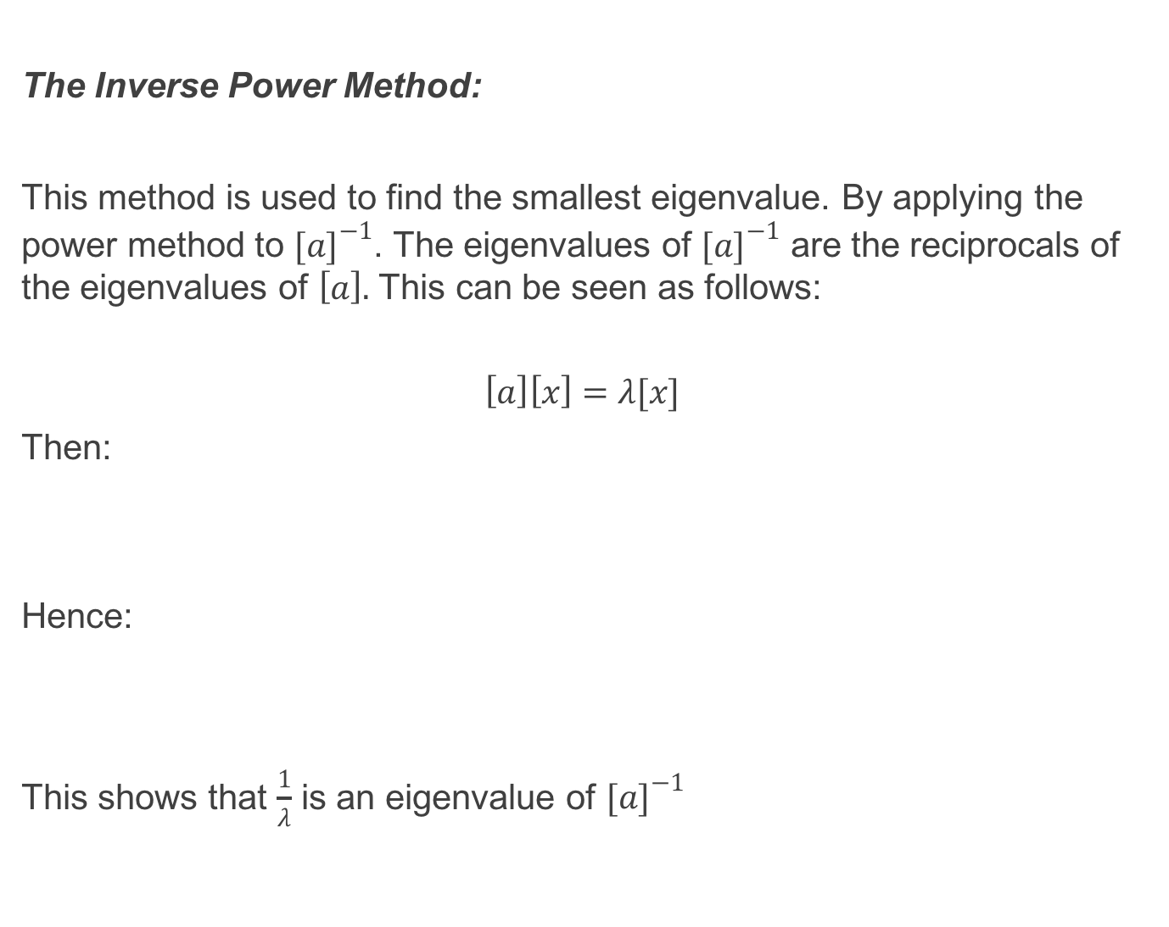
The Inverse Power Method:
This method is used to find the smallest eigenvalue. By applying the power method to ${[a]}^{−1}$. The eigenvalues of ${[a]}^{−1}$ are the reciprocals of the eigenvalues of $\left[a\right].$ This can be seen as follows:
$$\left[a\right]\left[x\right]=λ[x]$$
Then:
Hence:
This shows that $\frac{1}{λ}$ is an eigenvalue of ${[a]}^{−1}$

Slide 15
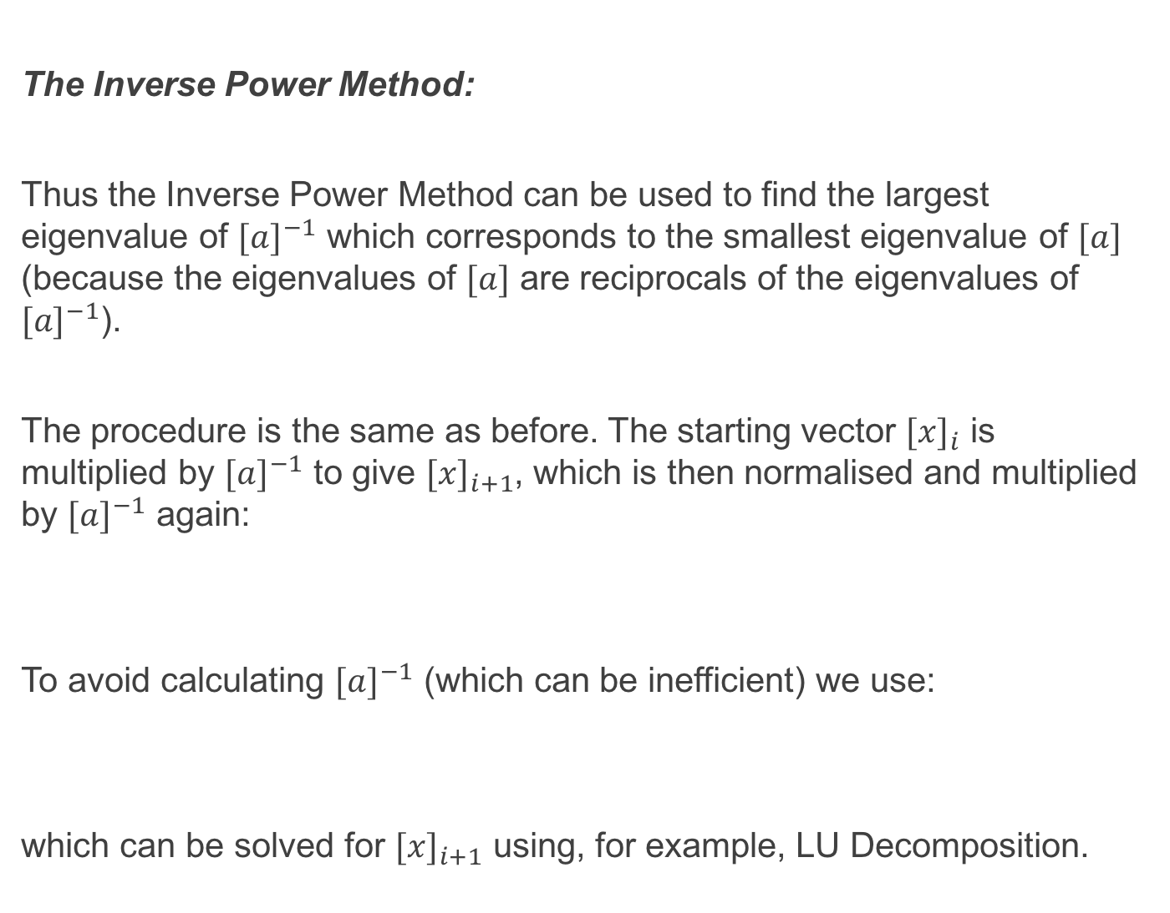
The Inverse Power Method:
Thus the Inverse Power Method can be used to find the largest eigenvalue of ${[a]}^{−1}$ which corresponds to the smallest eigenvalue of $[a]$ (because the eigenvalues of $[a]$ are reciprocals of the eigenvalues of ${[a]}^{−1}$).
The procedure is the same as before. The starting vector ${[x]}_{i}$ is multiplied by ${[a]}^{−1}$ to give ${[x]}_{i+1}$, which is then normalised and multiplied by ${[a]}^{−1}$ again:
To avoid calculating ${[a]}^{−1}$ (which can be inefficient) we use:
which can be solved for ${[x]}_{i+1}$ using, for example, LU Decomposition.

Slide 16
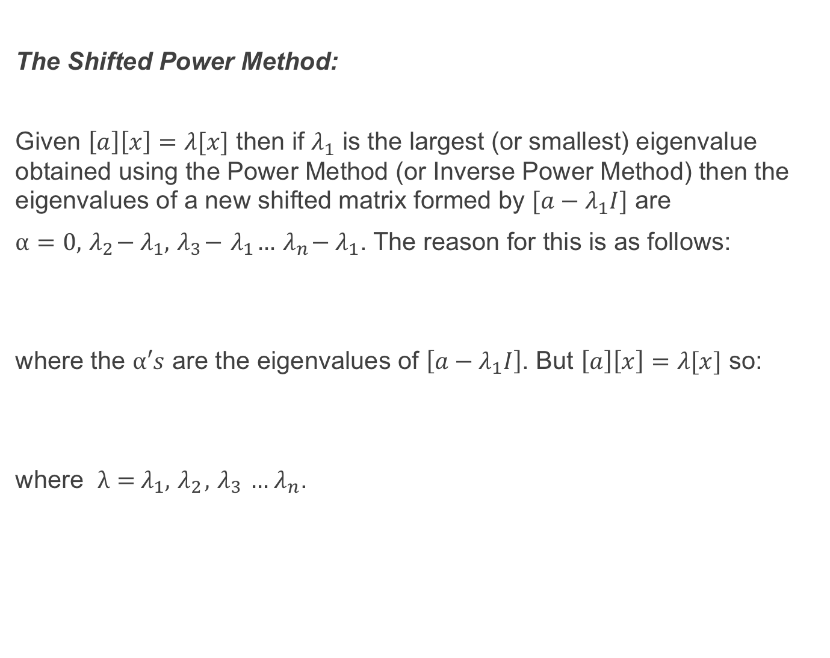
The Shifted Power Method:
Given $\left[a\right]\left[x\right]=λ[x]$ then if $λ_{1}$ is the largest (or smallest) eigenvalue obtained using the Power Method (or Inverse Power Method) then the eigenvalues of a new shifted matrix formed by $[a−λ_{1}I]$ are
$α=0, { λ}_{2}−{ λ}_{1},{ λ}_{3}−{ λ}_{1}…{ λ}_{n}−{ λ}_{1}$. The reason for this is as follows:
where the $α′s$ are the eigenvalues of $\left[a−λ_{1}I\right]$. But $\left[a\right]\left[x\right]=λ[x]$ so:
where $λ={ λ}_{1}, { λ}_{2},{ λ}_{3} …{ λ}_{n}$.

Slide 17
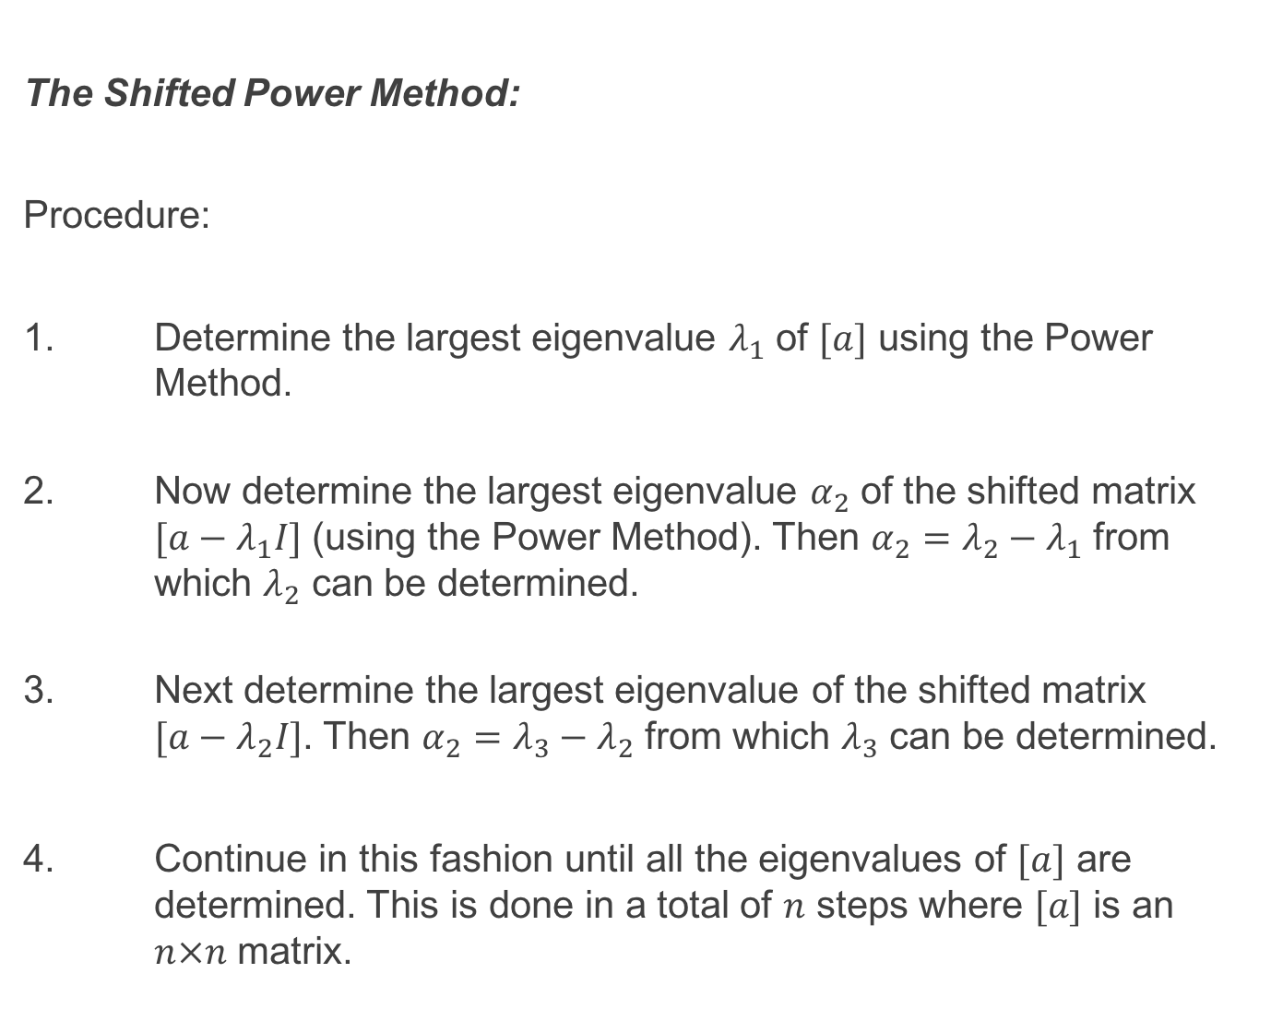
The Shifted Power Method:
Procedure:
1. Determine the largest eigenvalue $λ_{1}$ of $[a]$ using the Power Method.
2. Now determine the largest eigenvalue $α_{2}$ of the shifted matrix $[a−λ_{1}I]$ (using the Power Method). Then $α_{2}=λ_{2}−λ_{1}$ from which $λ_{2}$ can be determined.
3. Next determine the largest eigenvalue of the shifted matrix $[a−λ_{2}I]$. Then $α_{2}=λ_{3}−λ_{2}$ from which $λ_{3}$ can be determined.
4. Continue in this fashion until all the eigenvalues of $[a]$ are determined. This is done in a total of $n$ steps where $[a]$ is an $n×n$ matrix.

Slide 18
The Shifted Power Method:
The Shifted Power Method is an inefficient process. A preferred method for obtaining all eigenvalues of a matrix is the QR Factorisation Method. This is described next.

Slide 19
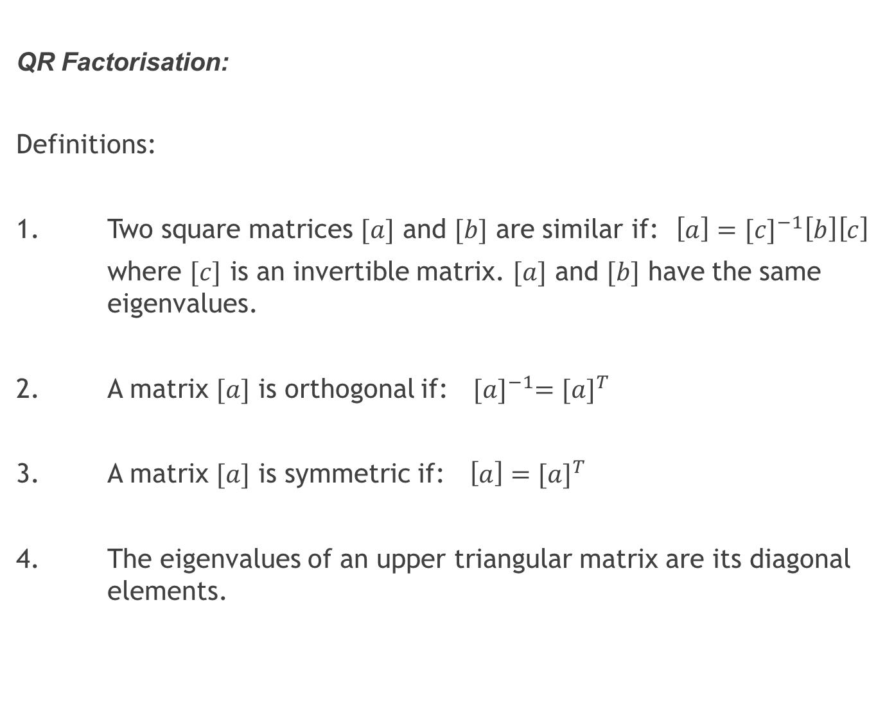
QR Factorisation:
Definitions:
1. Two square matrices $[a]$ and $[b]$ are similar if: $\left[a\right]={[c]}^{−1}\left[b\right]\left[c\right]$
where $[c]$ is an invertible matrix. $[a]$ and $[b]$ have the same eigenvalues.
2. A matrix $[a]$ is orthogonal if: ${[a]}^{−1}={[a]}^{T}$
3. A matrix $[a]$ is symmetric if: $\left[a\right]={[a]}^{T}$
4. The eigenvalues of an upper triangular matrix are its diagonal elements.

Slide 20
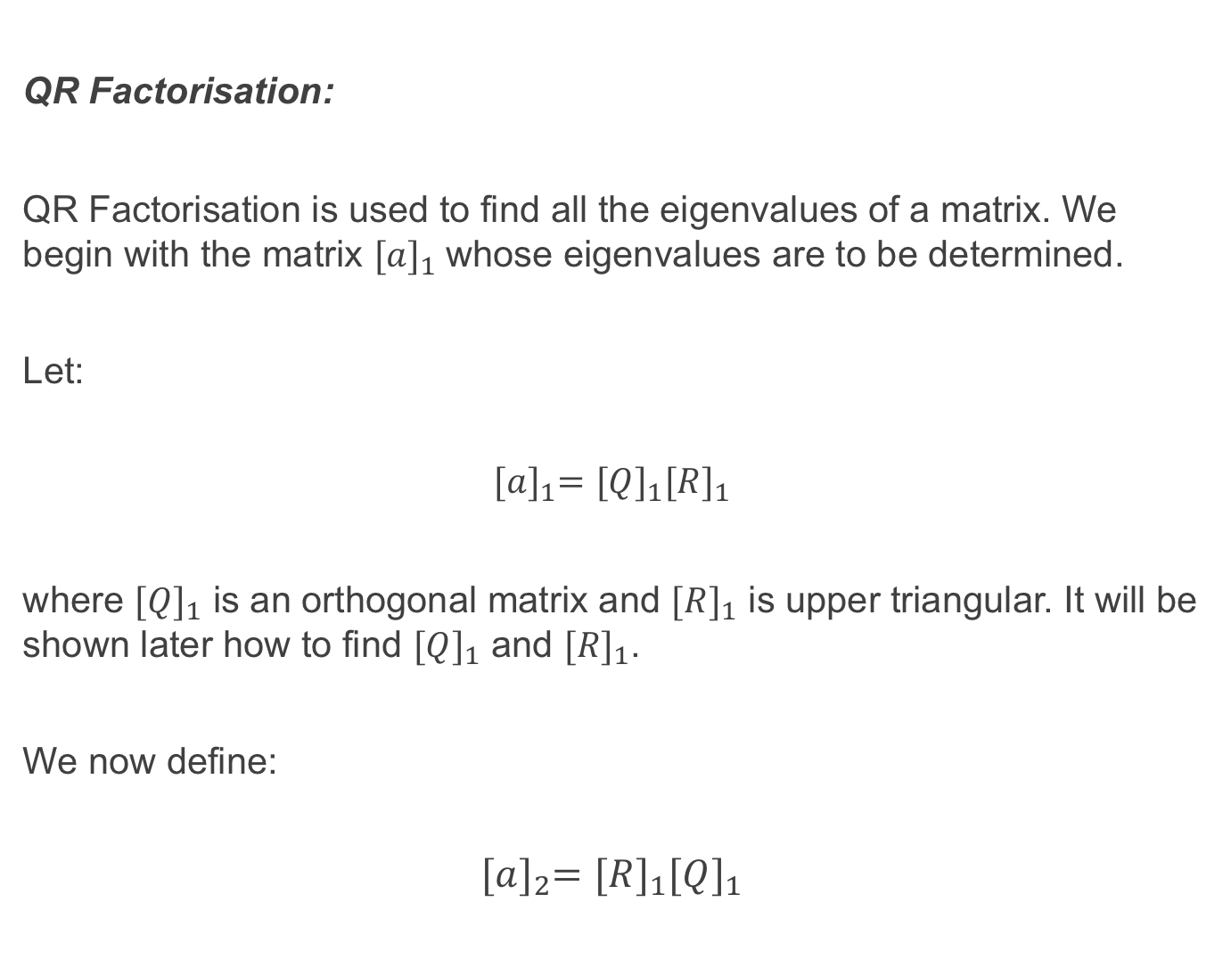
QR Factorisation:
QR Factorisation is used to find all the eigenvalues of a matrix. We begin with the matrix ${[a]}_{1}$whose eigenvalues are to be determined.
Let:
$${[a]}_{1}={[Q]}_{1}{[R]}_{1}$$
where ${[Q]}_{1}$ is an orthogonal matrix and ${[R]}_{1}$ is upper triangular. It will be shown later how to find ${[Q]}_{1}$ and ${[R]}_{1}$.
We now define:
$${[a]}_{2}={[R]}_{1}{[Q]}_{1}$$

Slide 21
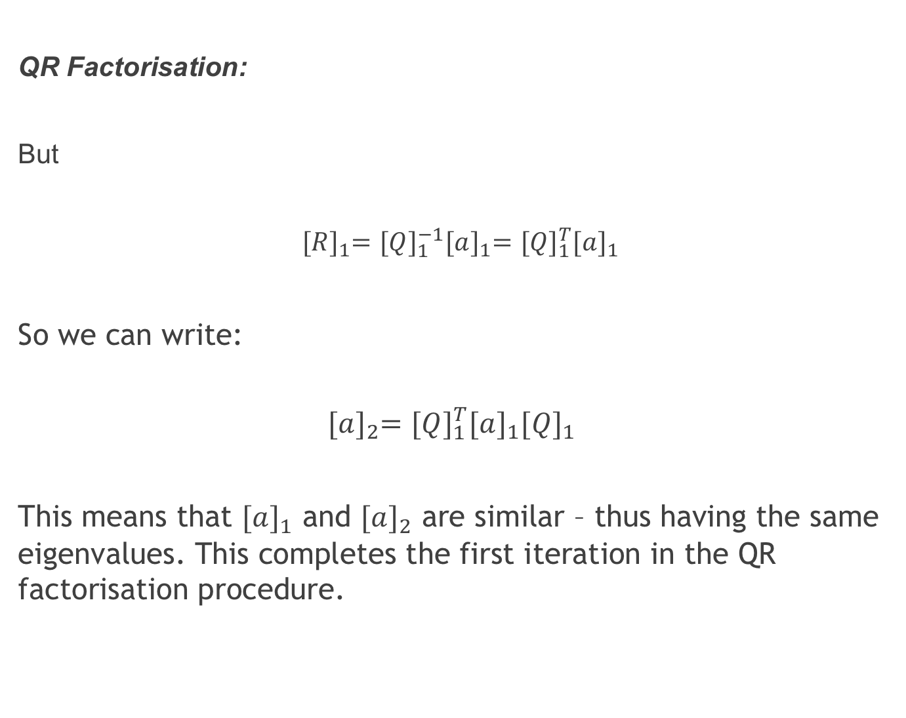
QR Factorisation:
But
${[R]}_{1}={[Q]}_{1}^{−1}{[a]}_{1}={[Q]}_{1}^{T}{[a]}_{1}$
So we can write:
$${[a]}_{2}={[Q]}_{1}^{T}{[a]}_{1}{[Q]}_{1}$$
This means that ${[a]}_{1}$ and ${[a]}_{2}$ are similar – thus having the same eigenvalues. This completes the first iteration in the QR factorisation procedure.

Slide 22
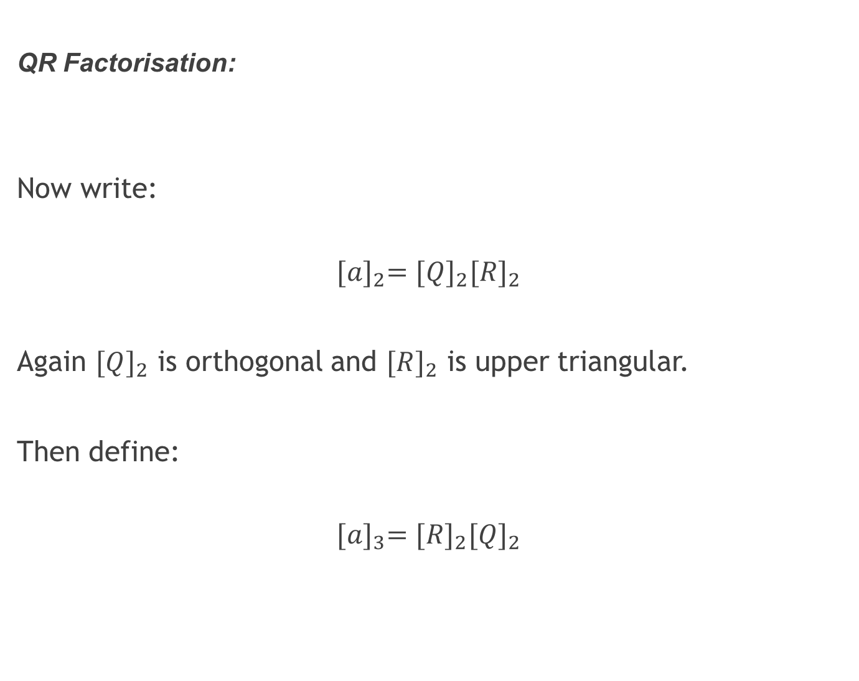
QR Factorisation:
Now write:
$${[a]}_{2}={[Q]}_{2}{[R]}_{2}$$
Again ${[Q]}_{2}$ is orthogonal and ${[R]}_{2}$ is upper triangular.
Then define:
$${[a]}_{3}={[R]}_{2}{[Q]}_{2}$$

Slide 23
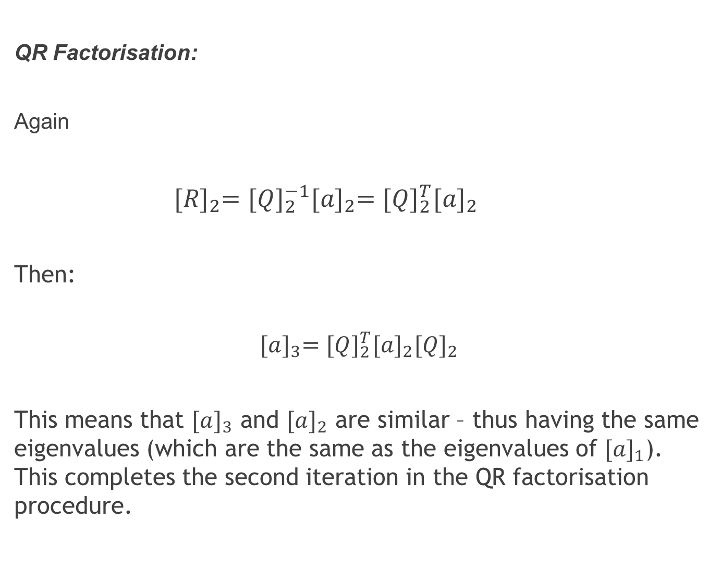
QR Factorisation:
Again
${[R]}_{2}={[Q]}_{2}^{−1}{[a]}_{2}={[Q]}_{2}^{T}{[a]}_{2}$
Then:
$${[a]}_{3}={[Q]}_{2}^{T}{[a]}_{2}{[Q]}_{2}$$
This means that ${[a]}_{3}$ and ${[a]}_{2}$ are similar – thus having the same eigenvalues (which are the same as the eigenvalues of ${[a]}_{1}$). This completes the second iteration in the QR factorisation procedure.

Slide 24
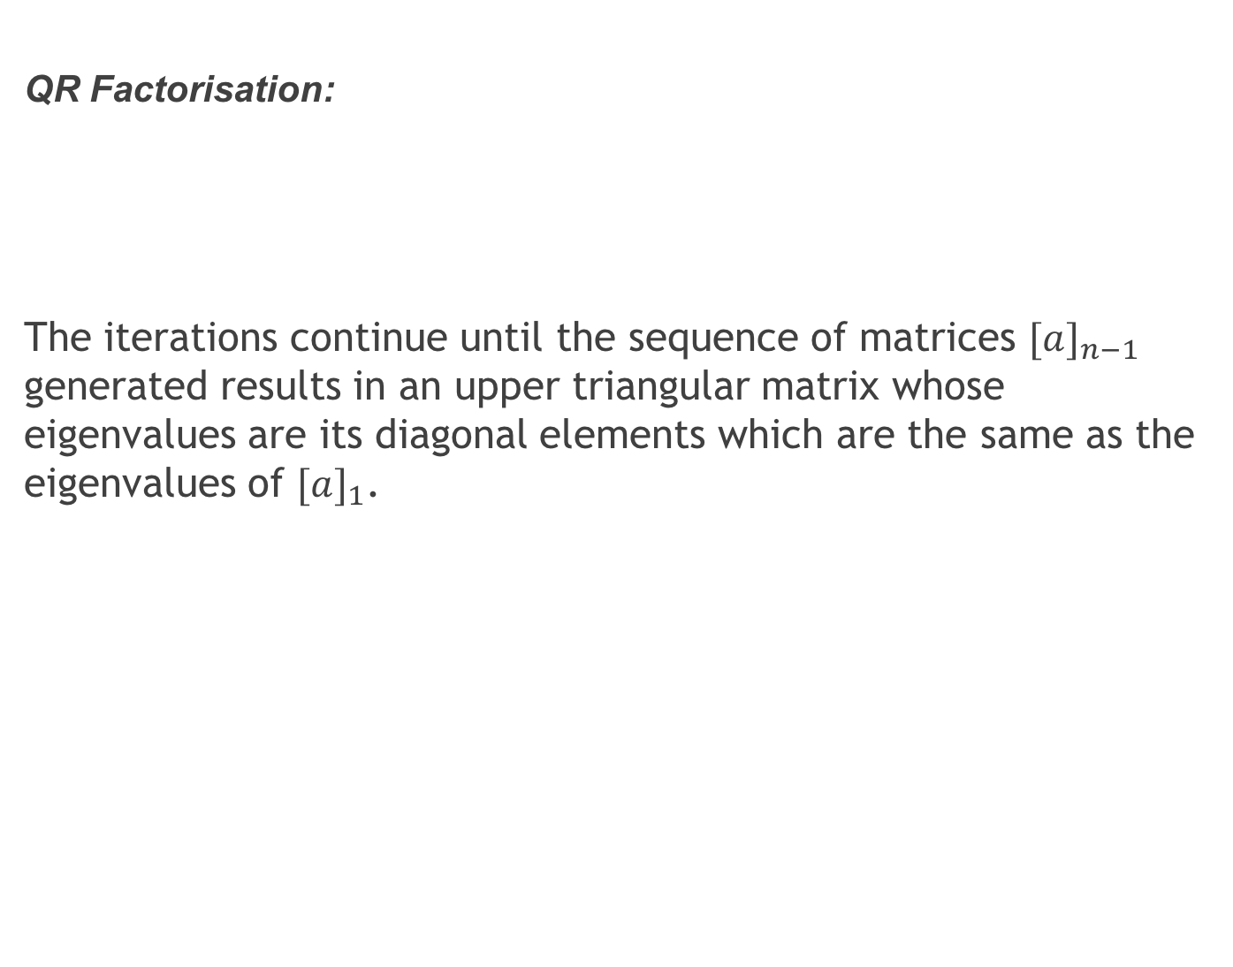
QR Factorisation:
The iterations continue until the sequence of matrices ${[a]}_{n−1}$ generated results in an upper triangular matrix whose eigenvalues are its diagonal elements which are the same as the eigenvalues of ${[a]}_{1}$.

Slide 25
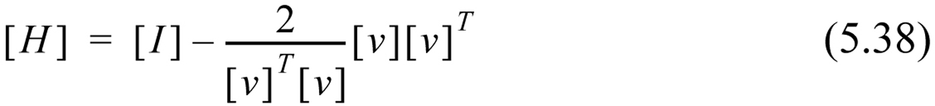
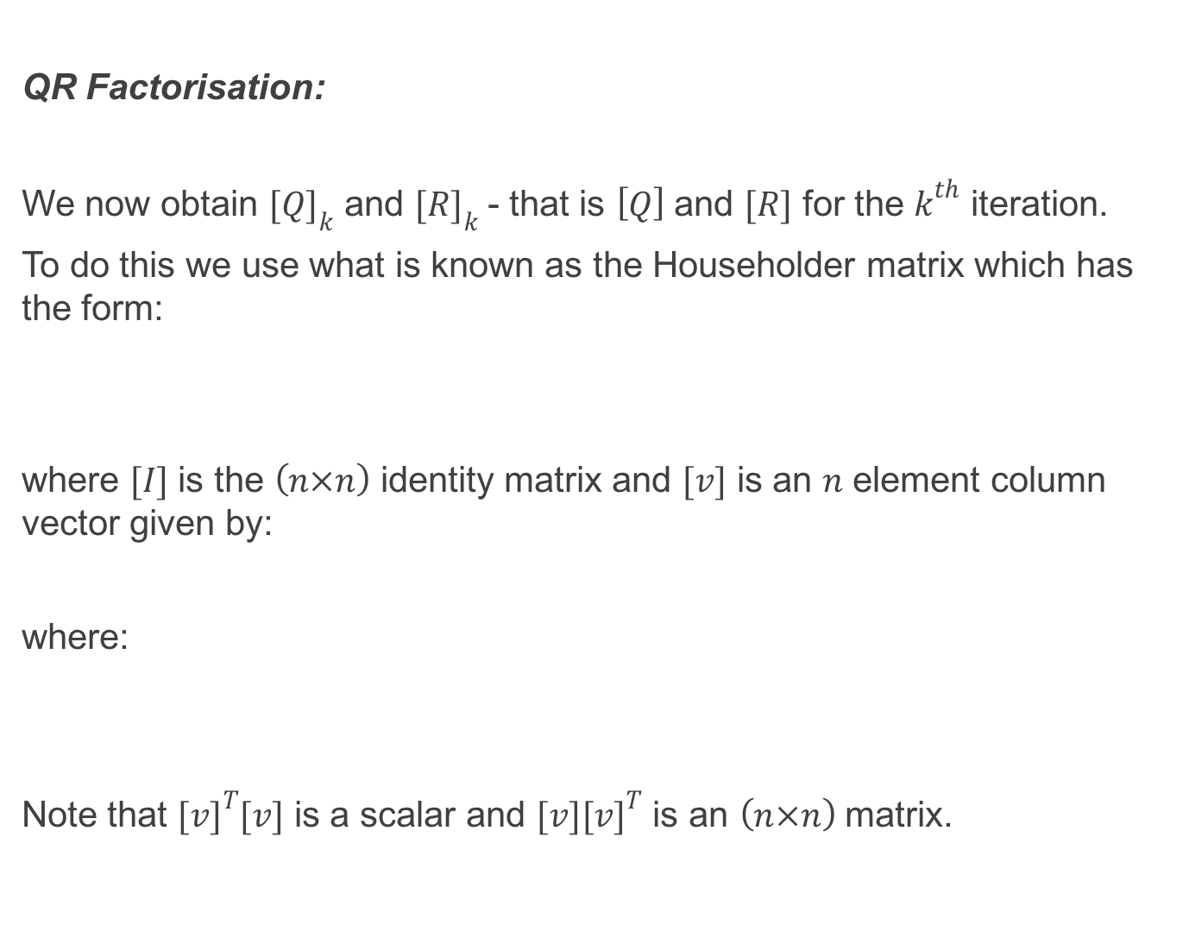
QR Factorisation:
We now obtain ${[Q]}_{k}$ and ${[R]}_{k}$ - that is $\left[Q\right]$ and $[R]$ for the $k^{th}$ iteration.
To do this we use what is known as the Householder matrix which has the form:
where $[I]$ is the $\left(n×n\right)$ identity matrix and $[v]$ is an $n$ element column vector given by:
where:
Note that ${[v]}^{T}[v]$ is a scalar and $[v]{[v]}^{T}$ is an $\left(n×n\right)$ matrix.

Slide 26
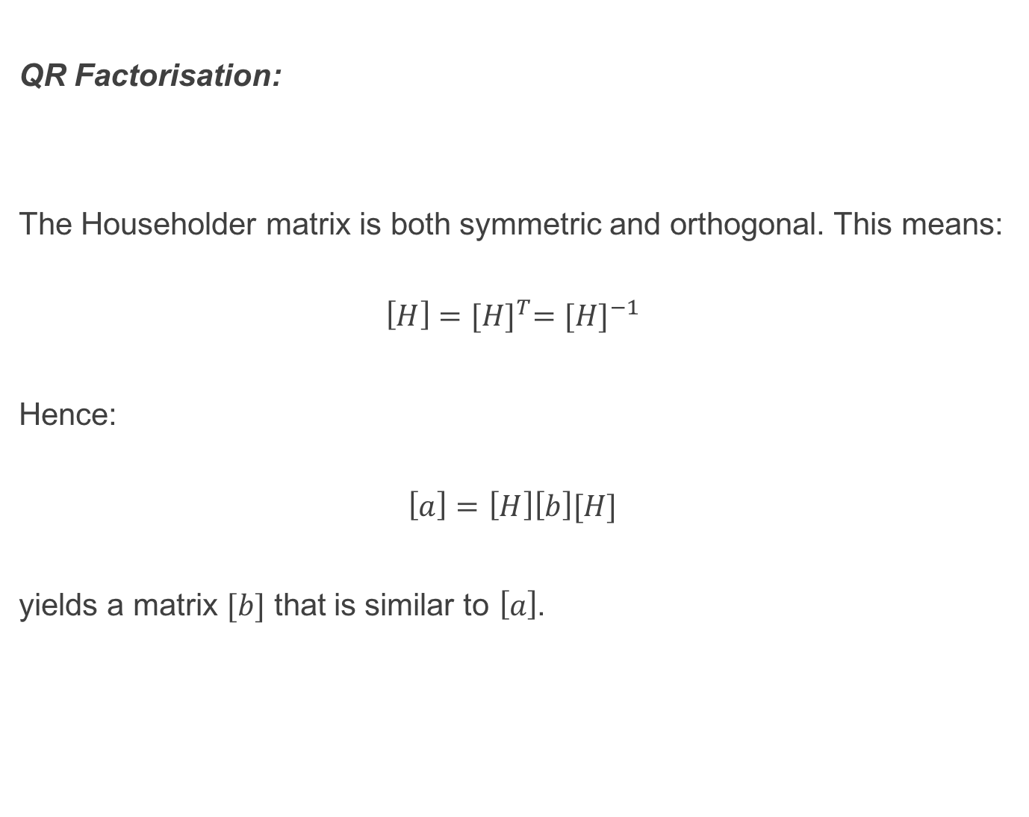
QR Factorisation:
The Householder matrix is both symmetric and orthogonal. This means:
$$\left[H\right]{=[H]}^{T}={[H]}^{−1}$$
Hence:
$$\left[a\right]=\left[H\right]\left[b\right][H]$$
yields a matrix $[b]$ that is similar to $\left[a\right]$.

Slide 27
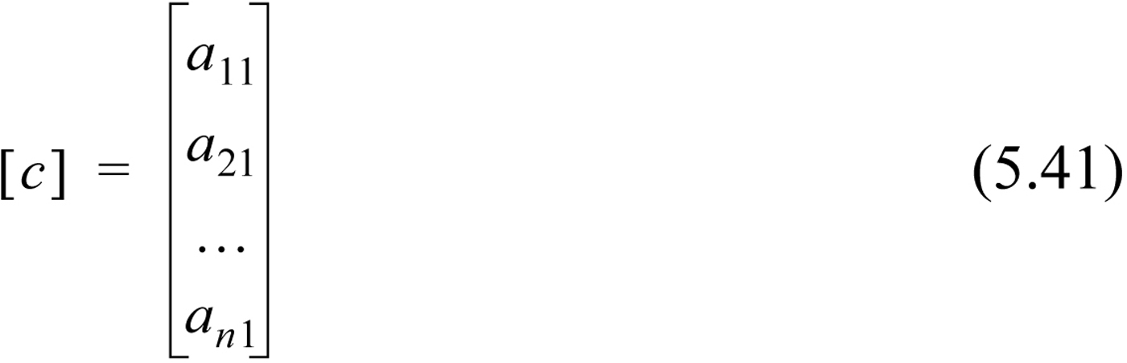
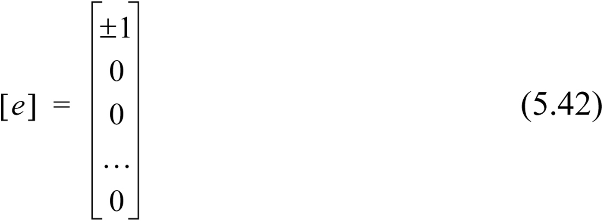
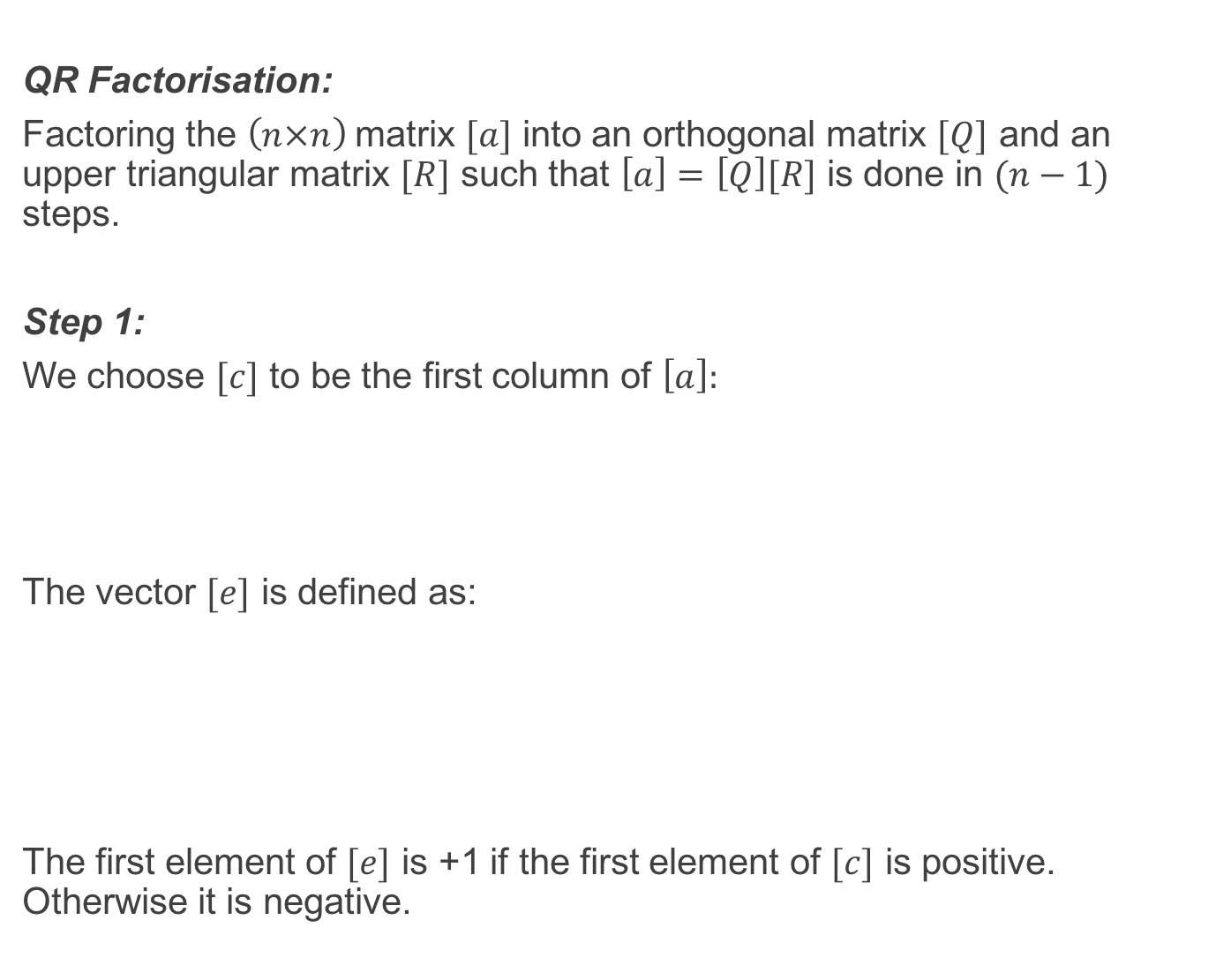
QR Factorisation:
Factoring the $\left(n×n\right)$matrix $[a]$ into an orthogonal matrix $[Q]$ and an upper triangular matrix $[R]$ such that $\left[a\right]=\left[Q\right][R]$ is done in $(n−1)$ steps.
Step 1:
We choose $[c]$ to be the first column of $\left[a\right]:$
The vector $[e]$ is defined as:
The first element of $[e]$ is +1 if the first element of $[c]$ is positive. Otherwise it is negative.

Slide 28
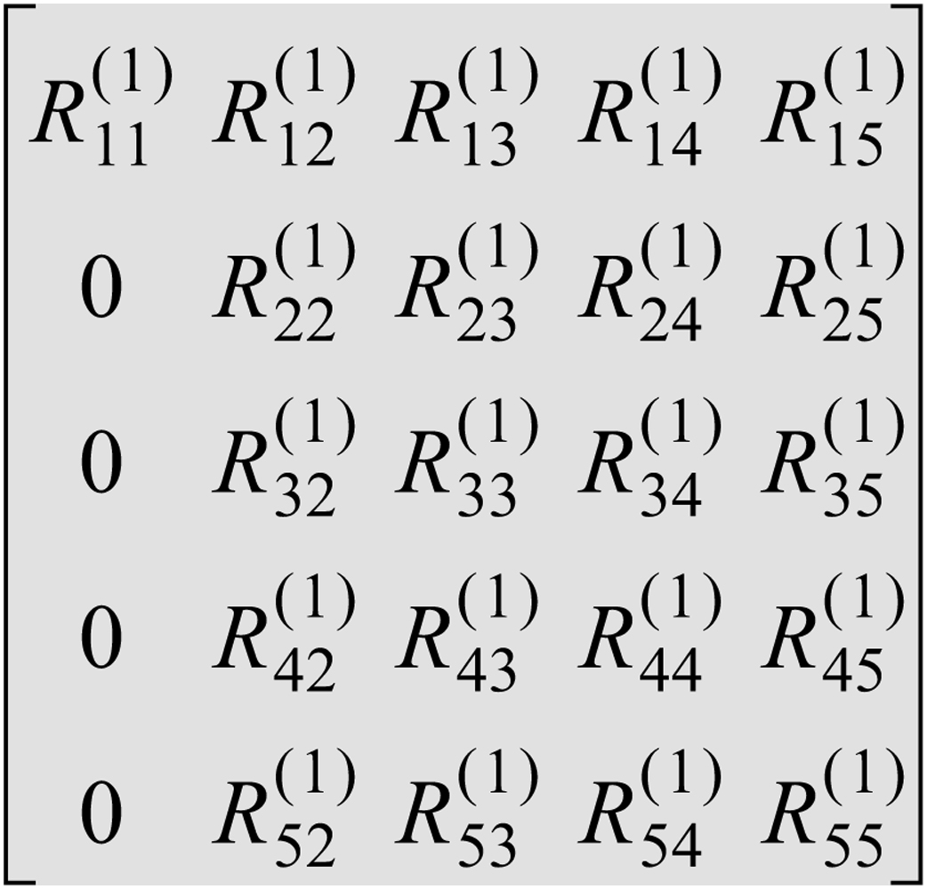
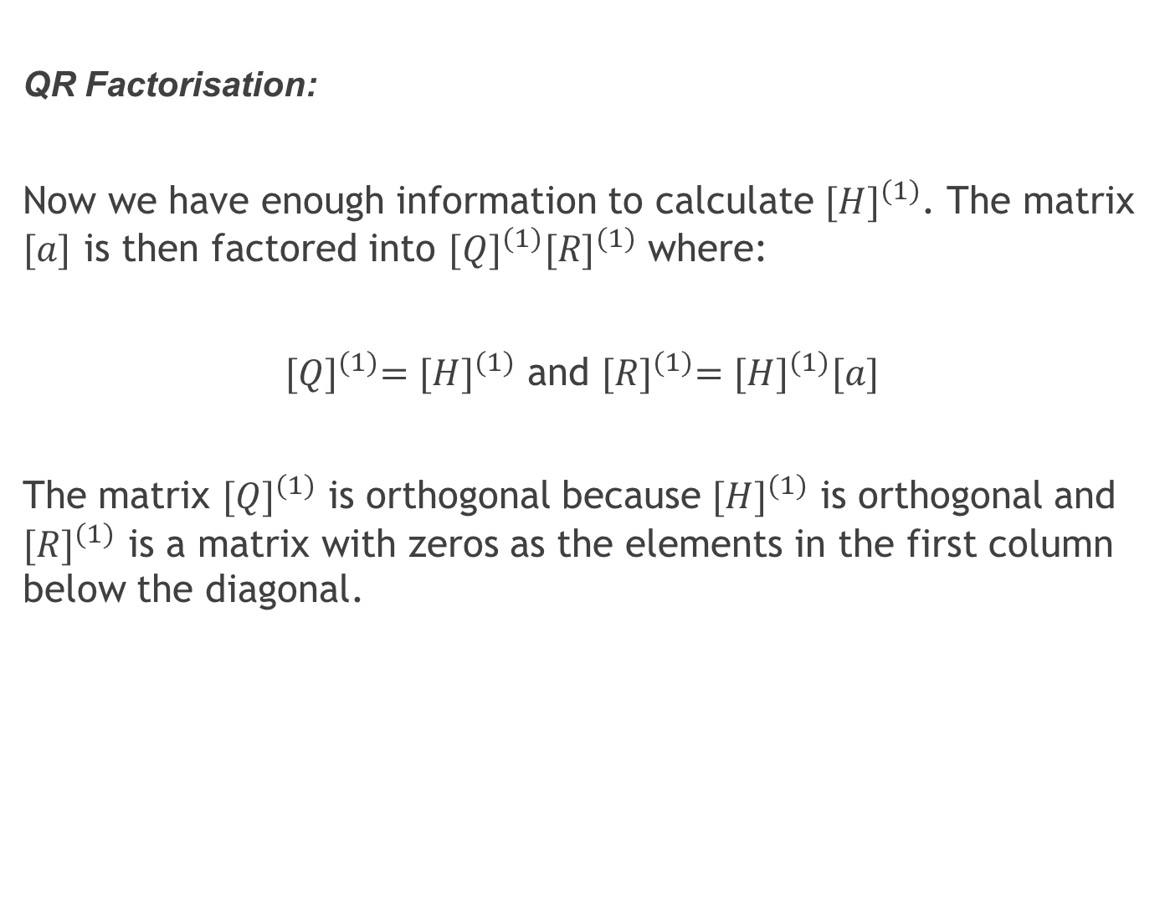
QR Factorisation:
Now we have enough information to calculate ${[H]}^{(1)}$. The matrix $[a]$ is then factored into ${[Q]}^{(1)}{[R]}^{(1)}$ where:
${[Q]}^{(1)}={[H]}^{(1)}$ and ${[R]}^{(1)}={[H]}^{(1)}[a]$
The matrix ${[Q]}^{(1)}$ is orthogonal because ${[H]}^{(1)}$ is orthogonal and ${[R]}^{(1)}$ is a matrix with zeros as the elements in the first column below the diagonal.

Slide 29
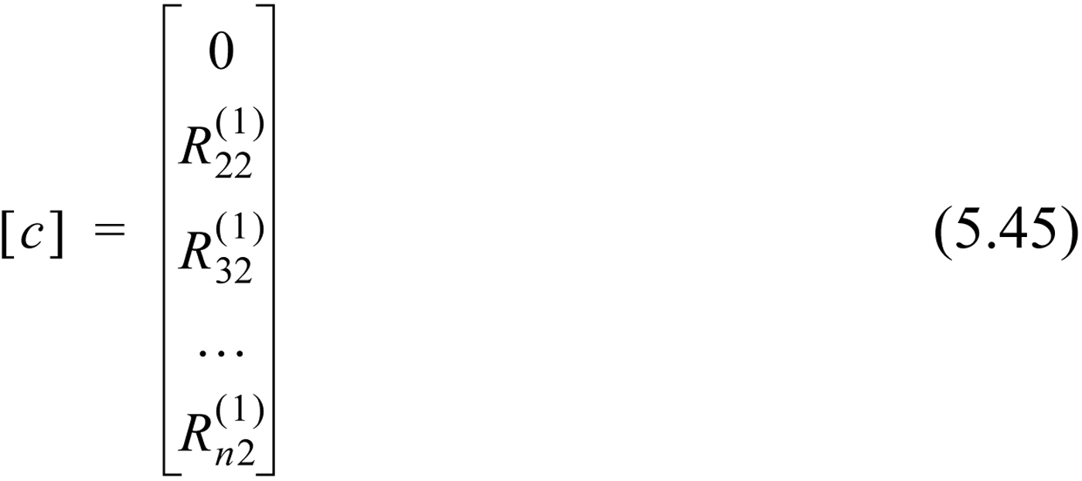
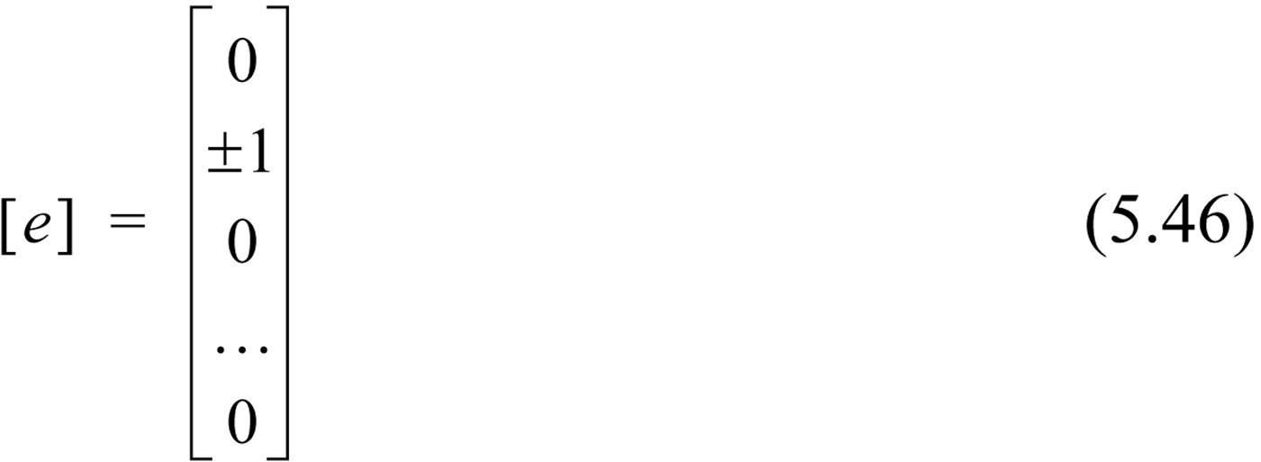
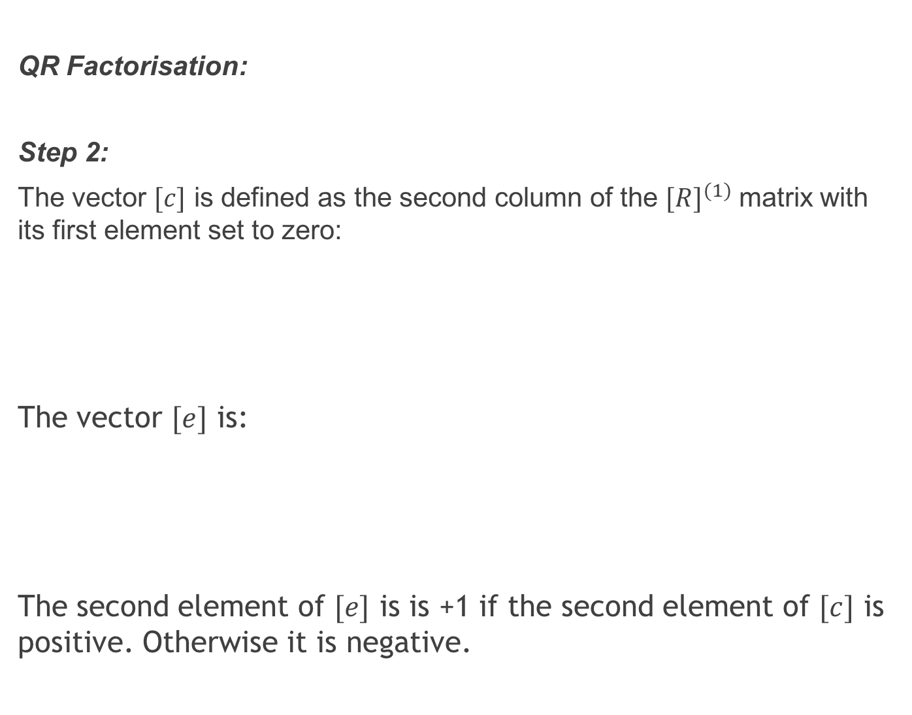
QR Factorisation:
Step 2:
The vector $[c]$ is defined as the second column of the ${[R]}^{(1)}$ matrix with its first element set to zero:
The vector $[e]$ is:
The second element of $[e]$ is is +1 if the second element of $[c]$ is positive. Otherwise it is negative.

Slide 30
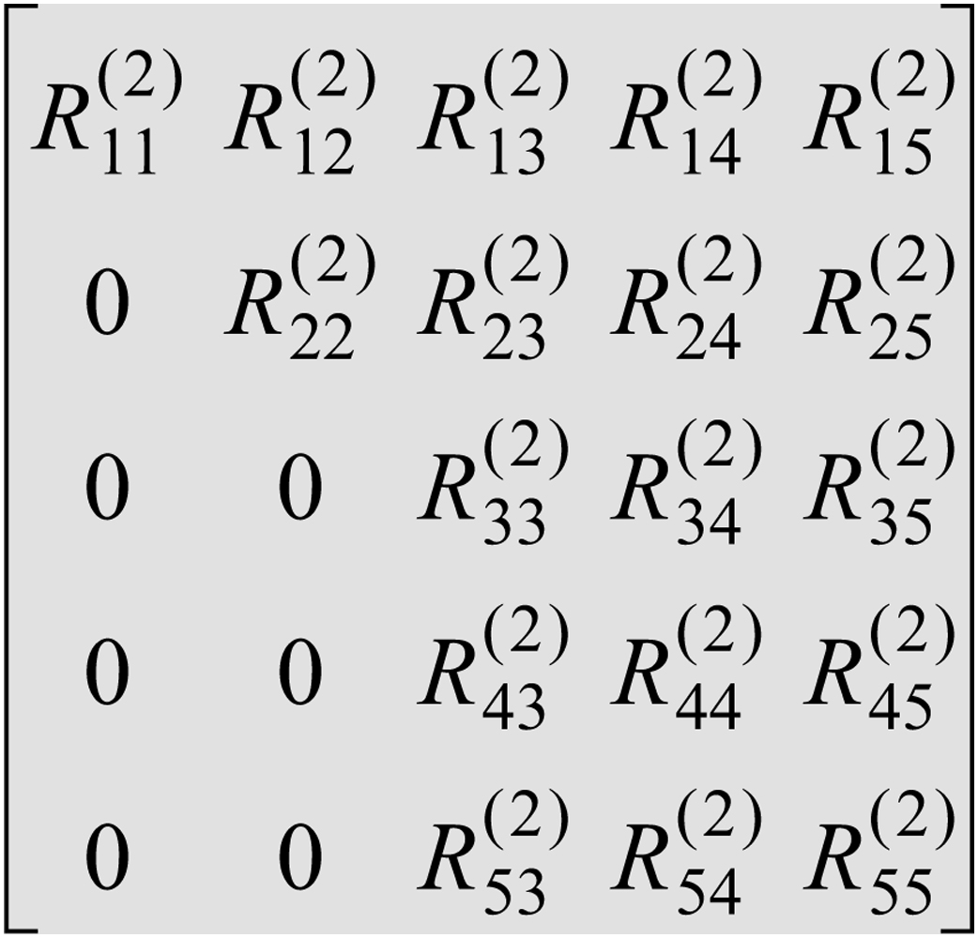
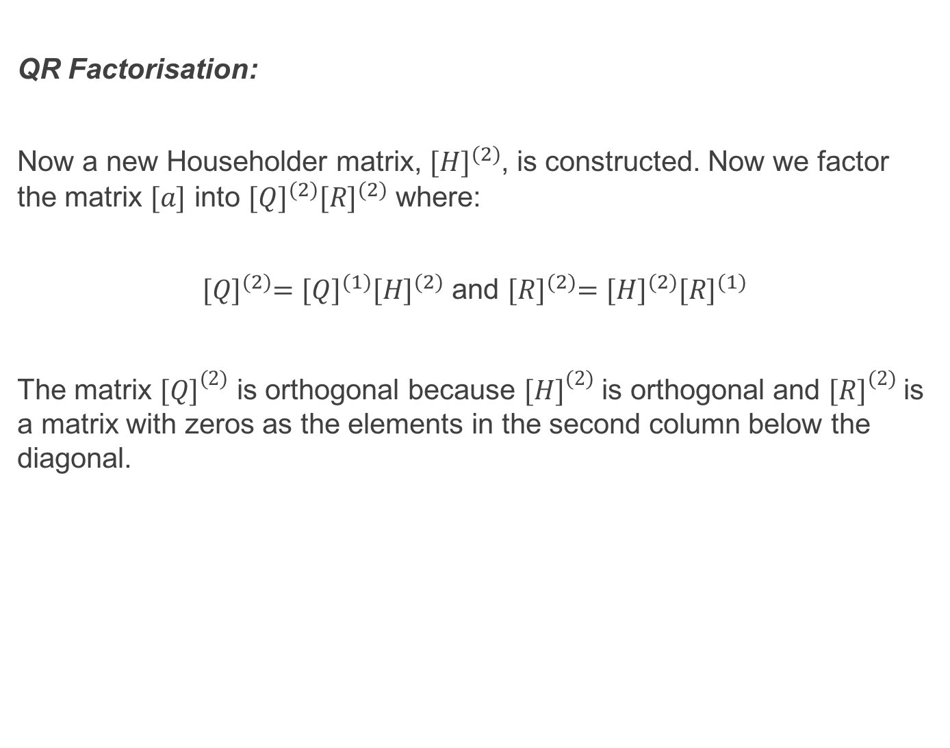
QR Factorisation:
Now a new Householder matrix, ${[H]}^{(2)}$, is constructed. Now we factor the matrix $[a]$ into ${[Q]}^{(2)}{[R]}^{(2)}$ where:
${[Q]}^{(2)}={[Q]}^{(1)}{[H]}^{(2)}$ and ${[R]}^{(2)}={[H]}^{(2)}{[R]}^{(1)}$
The matrix ${[Q]}^{(2)}$ is orthogonal because ${[H]}^{(2)}$ is orthogonal and ${[R]}^{(2)}$ is a matrix with zeros as the elements in the second column below the diagonal.

Slide 31
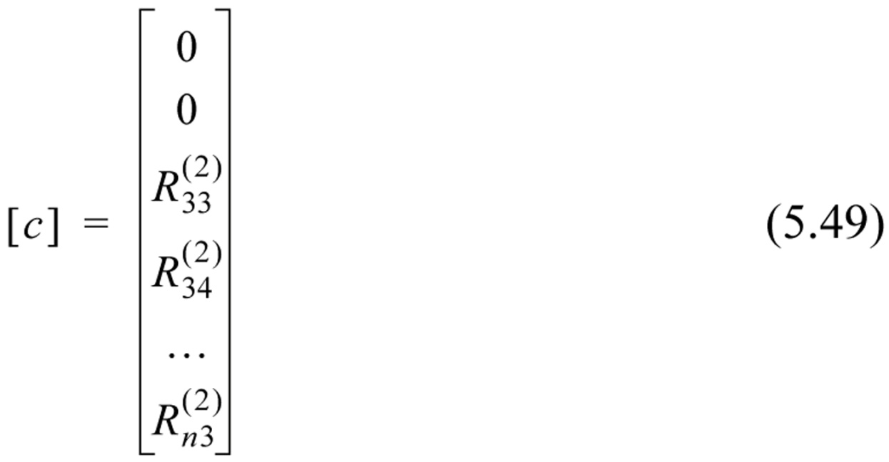
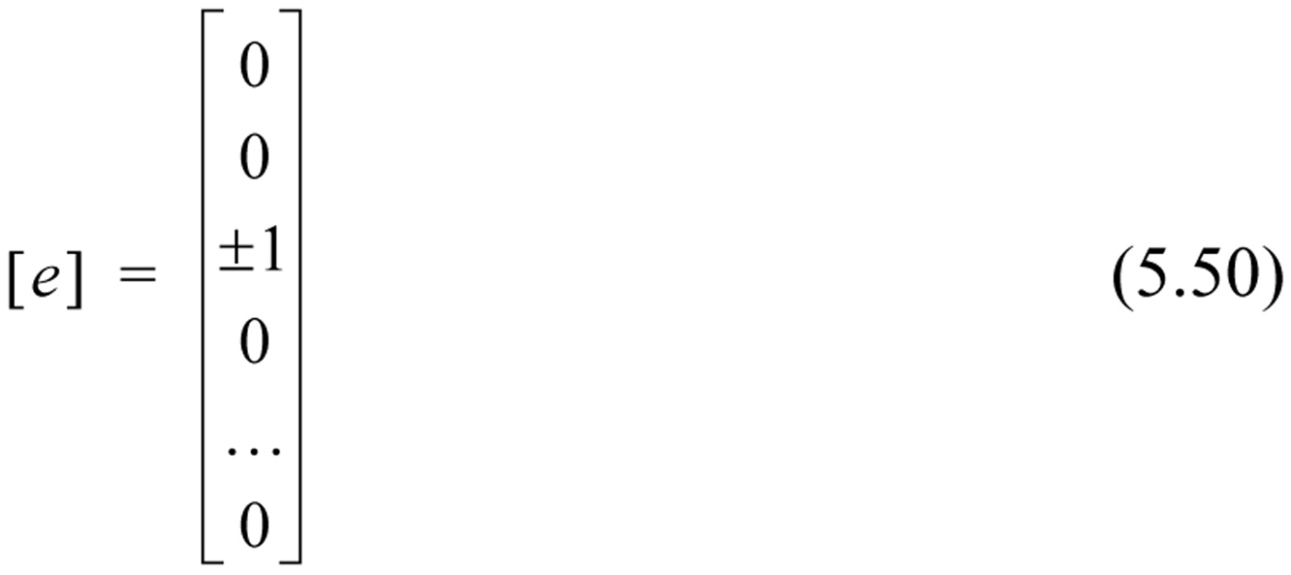
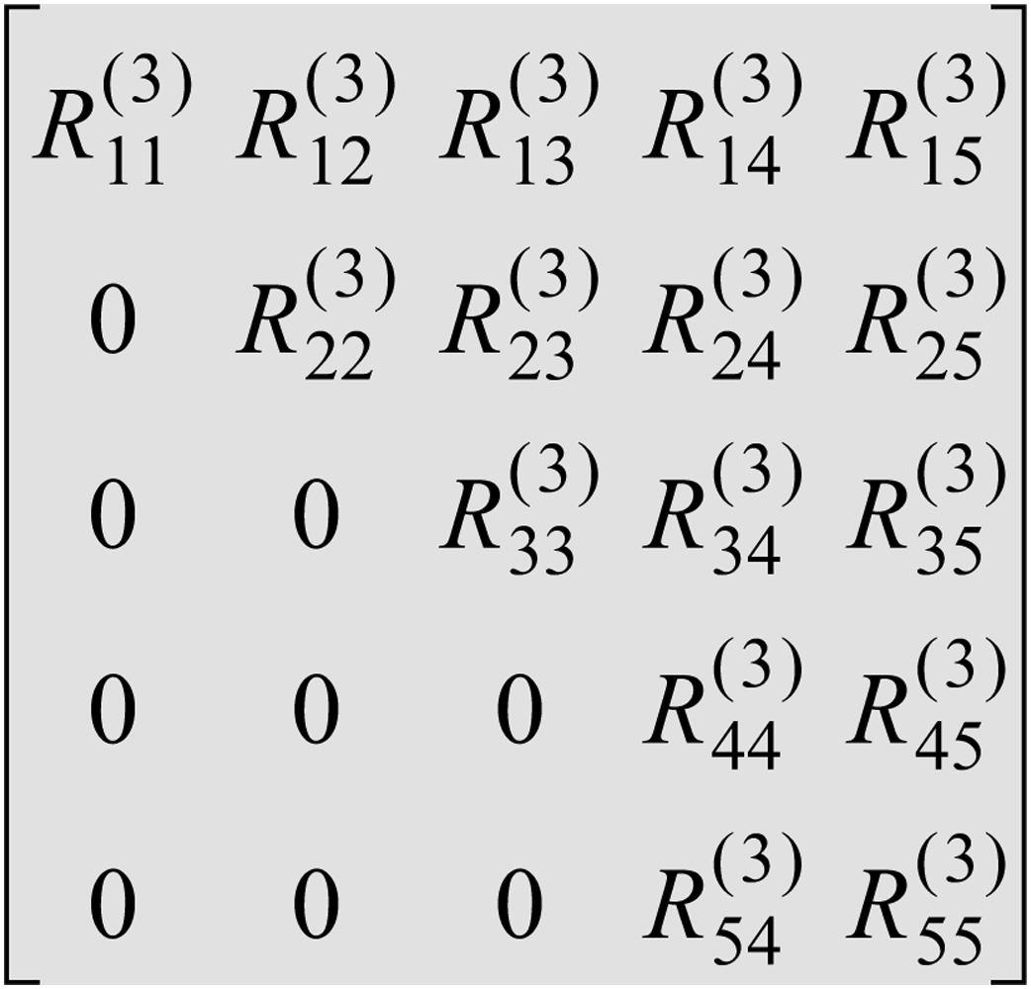
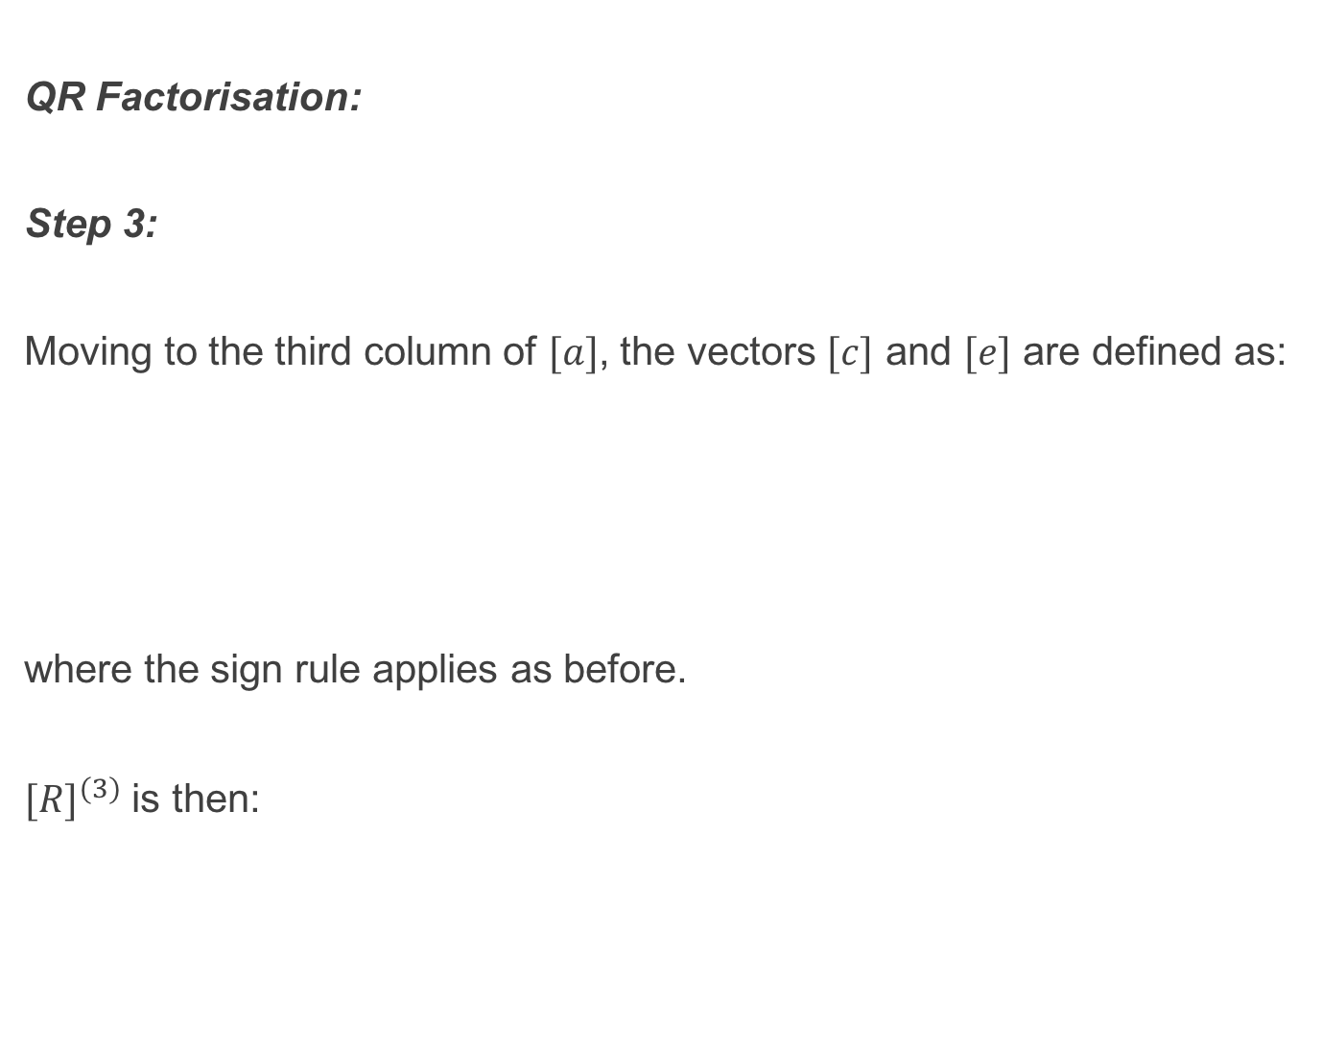
QR Factorisation:
Step 3:
Moving to the third column of $[a]$, the vectors $[c]$ and $[e]$ are defined as:
where the sign rule applies as before.
${[R]}^{(3)}$ is then:

Slide 32
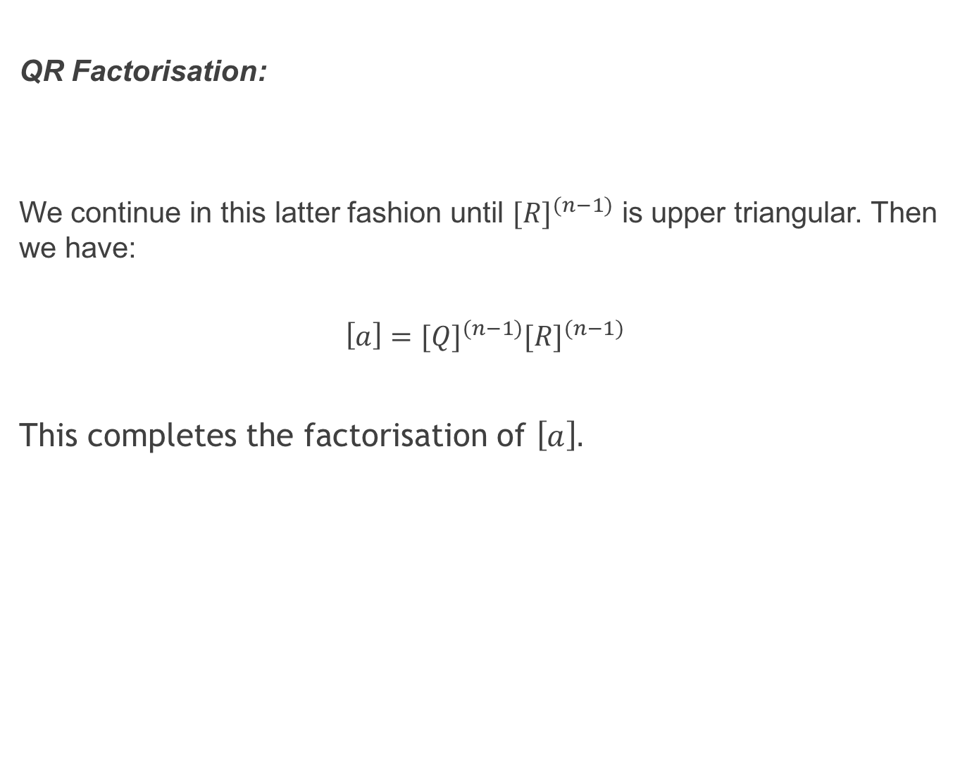
QR Factorisation:
We continue in this latter fashion until ${[R]}^{(n−1)}$ is upper triangular. Then we have:
$$\left[a\right]={[Q]}^{(n−1)}{[R]}^{(n−1)}$$
This completes the factorisation of $\left[a\right].$

Slide 33
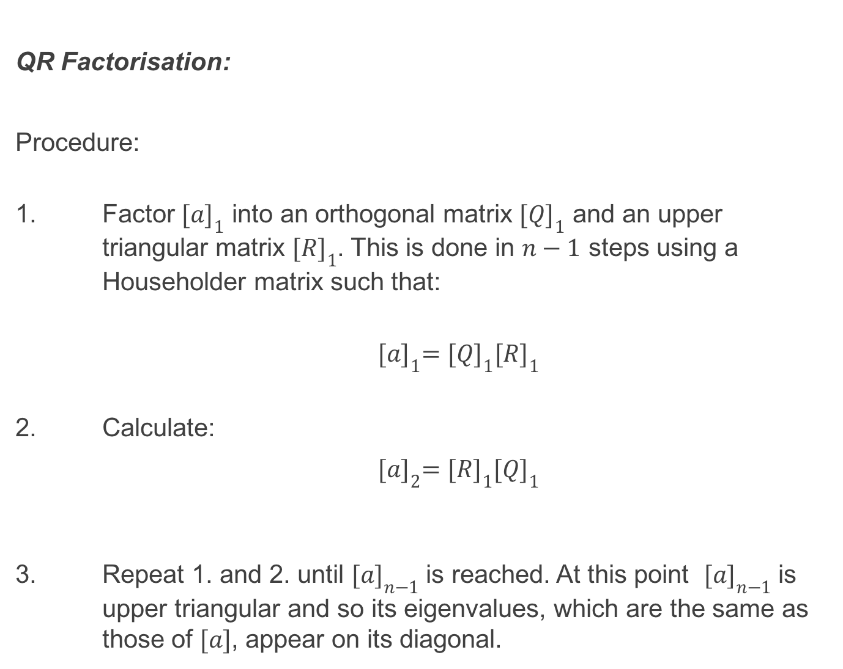
QR Factorisation:
Procedure:
1. Factor ${[a]}_{1}$ into an orthogonal matrix ${[Q]}_{1}$ and an upper triangular matrix ${[R]}_{1}$. This is done in $n−1$ steps using a Householder matrix such that:
${[a]}_{1}={[Q]}_{1}{[R]}_{1}$
2. Calculate:
${[a]}_{2}={[R]}_{1}{[Q]}_{1}$
3. Repeat 1. and 2. until ${[a]}_{n−1}$ is reached. At this point ${[a]}_{n−1}$ is upper triangular and so its eigenvalues, which are the same as those of $[a]$, appear on its diagonal.

Slide 34
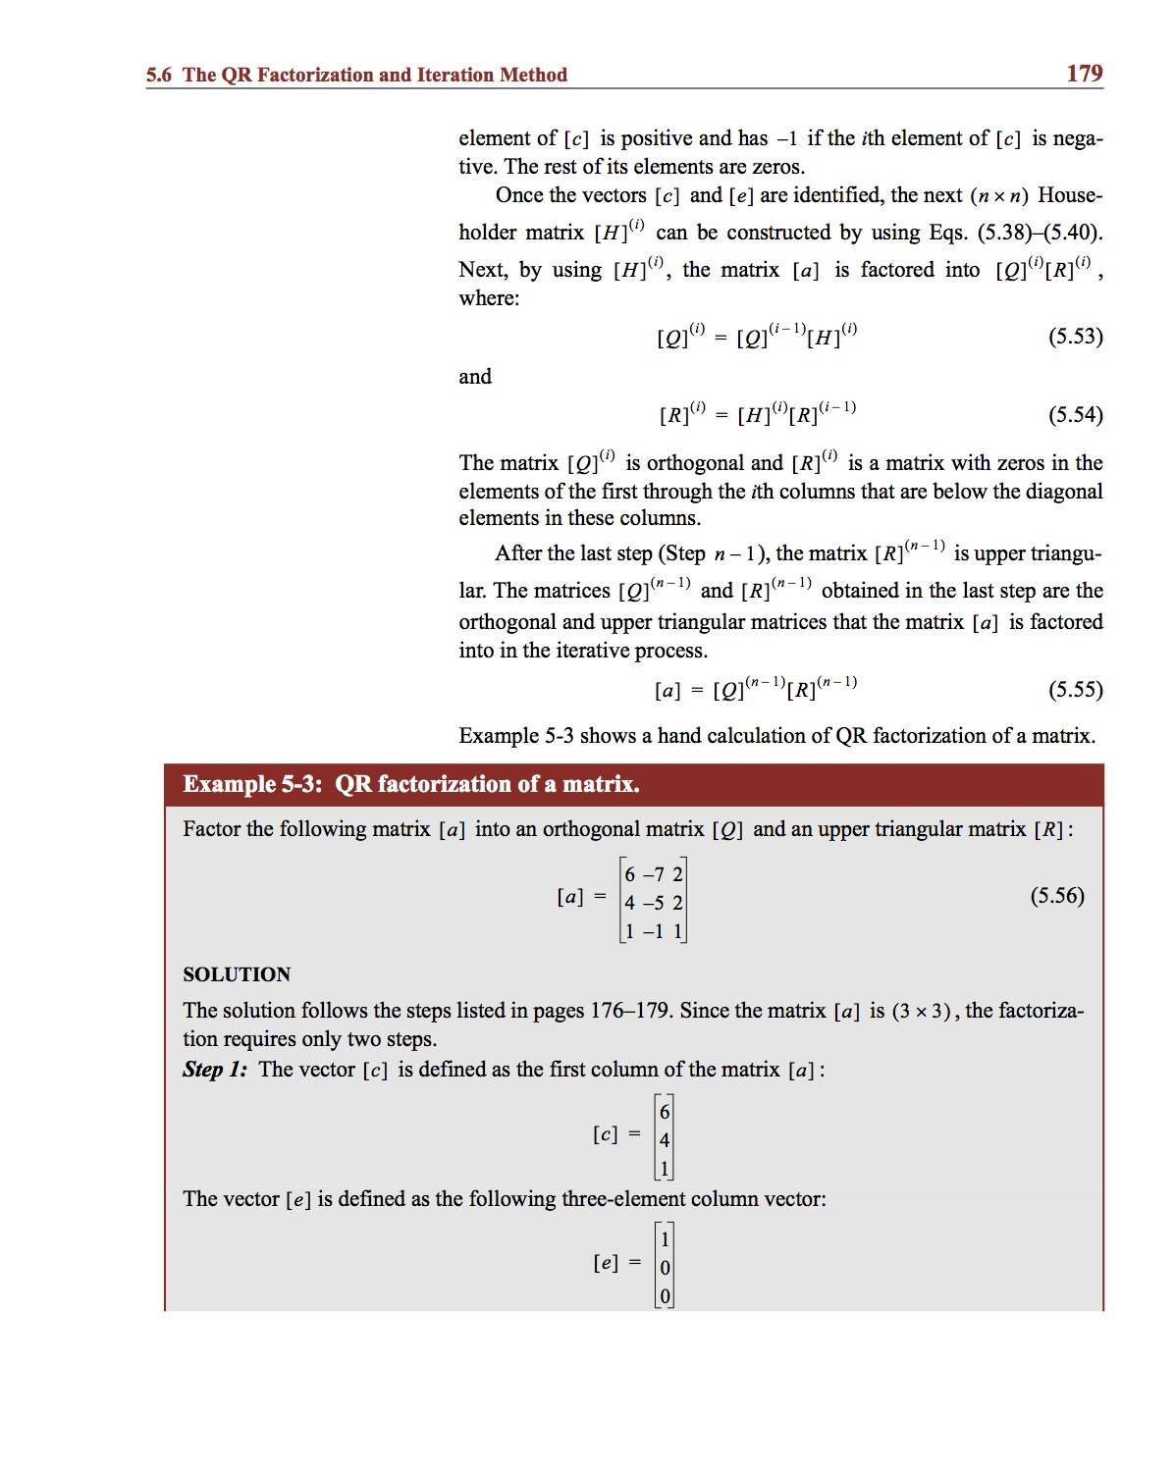
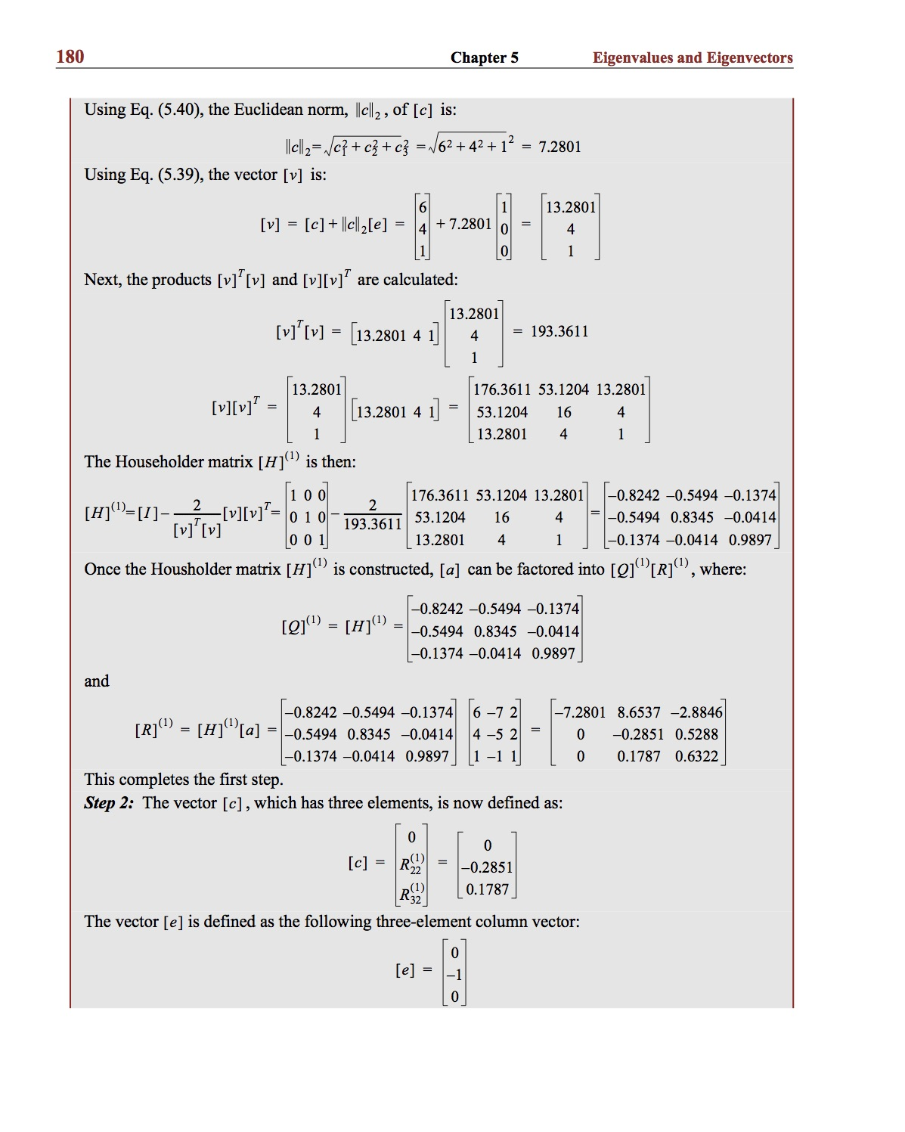
Example:

Slide 35
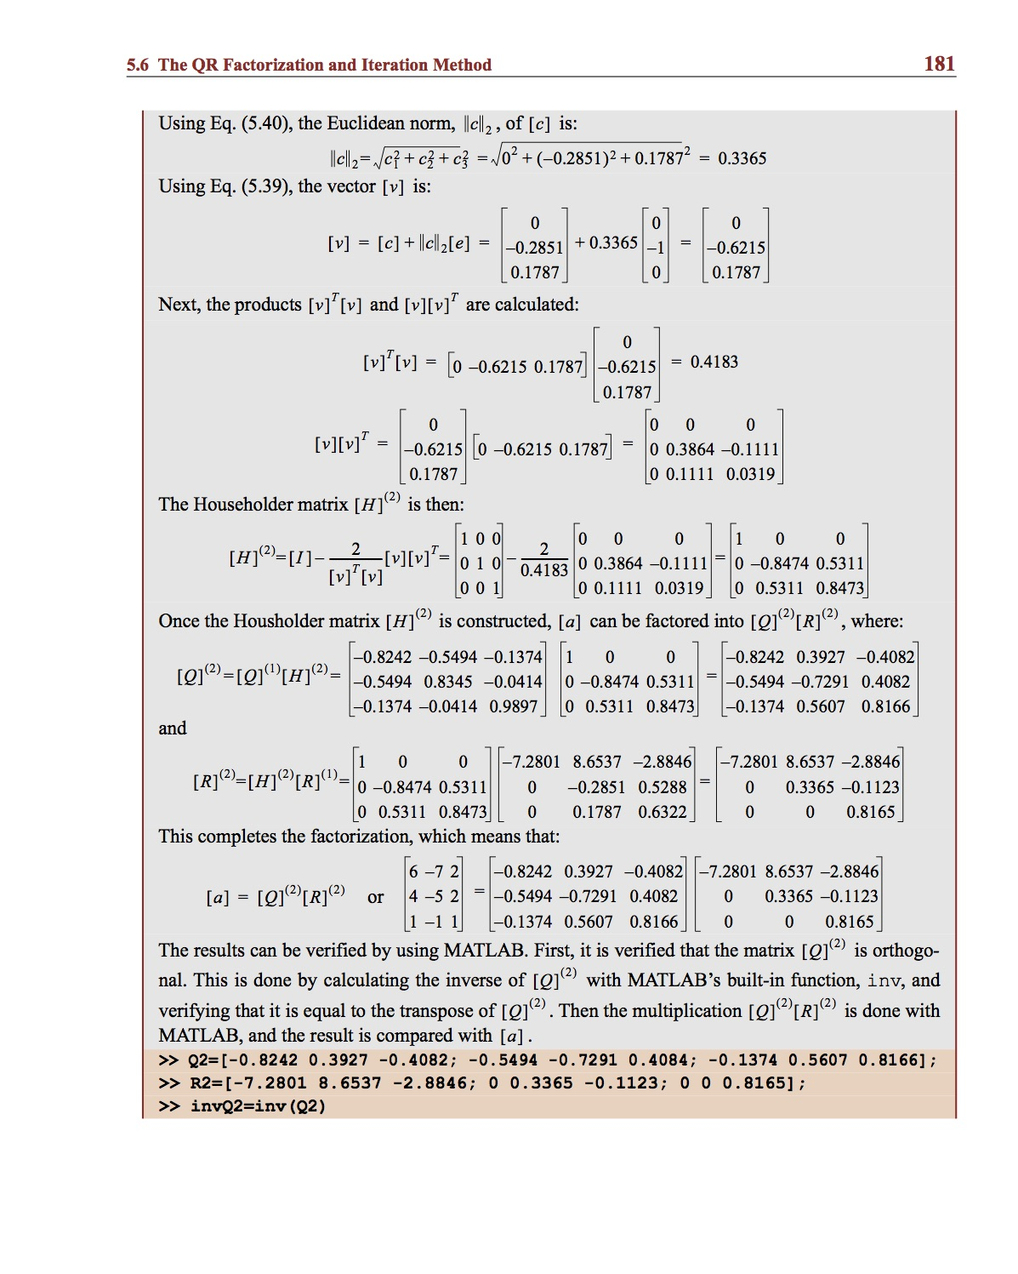
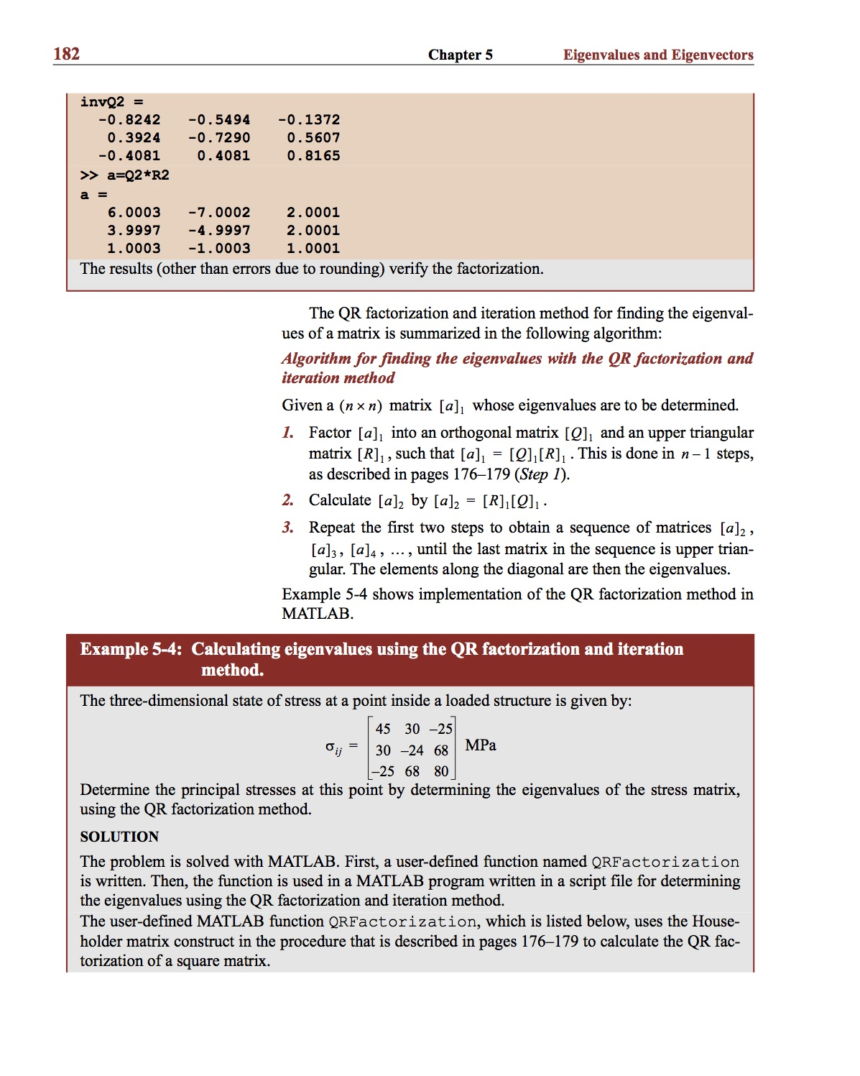
Example:

Slide 36
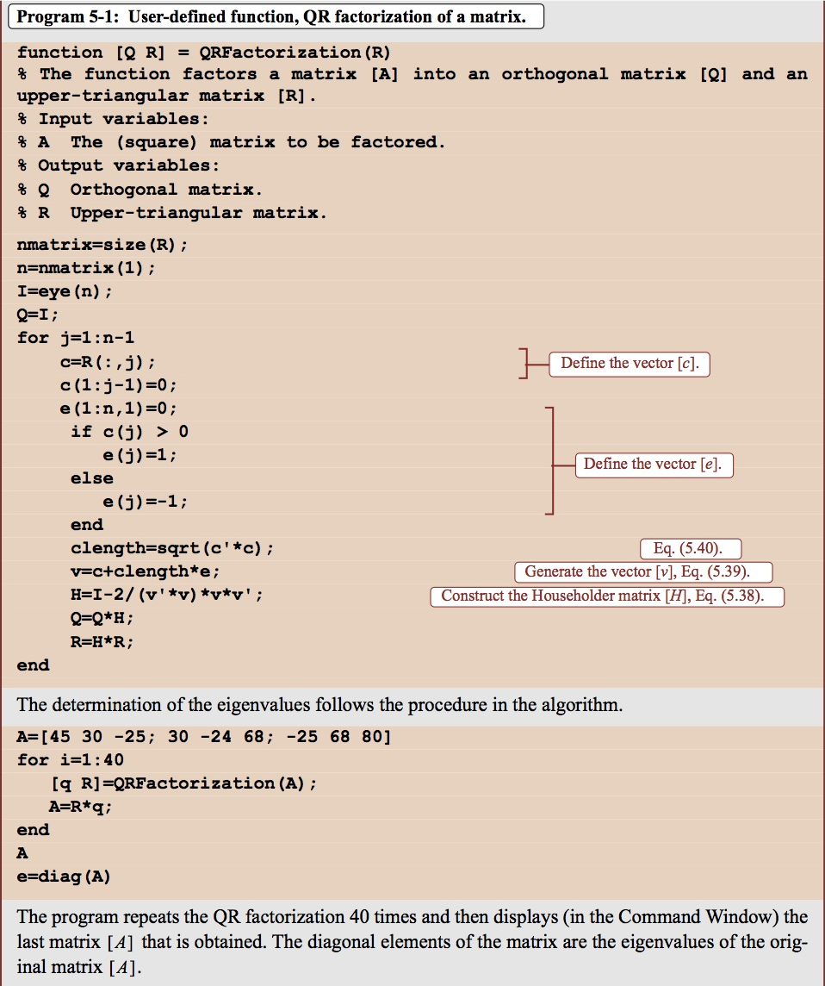
Example:

Slide 37
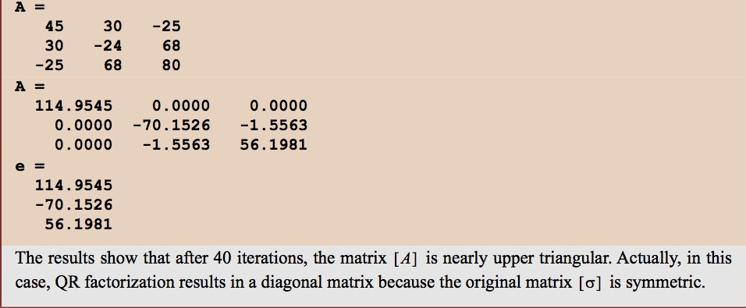
Example:

Slide 38
Recommended Problems:
Problems to be solved by hand (do at least 2):
5.3, 5.7, 5.9
Problems to be programmed in MATLAB (do at least 1):
5.10, 5.12
Problems in Science and Engineering:
5.18
You should pick out problems that you find interesting/challenging and do these too.

